Slide 1
READY

Slide 2
SMP ISLAM SABILILLAH MALANG
Jln Terusan Piranha Atas No 135 Malang
Media Pembelajaran Interaktif WCS
Unit 1 : Color Matters
Kelas VIII
oleh: Chasanatun Mujrikhah
www.elearningsmp.sekolahsabilillah.sch.id

Slide 3
CONTENT
INTRODUCTION
COLOR MATTERS
BASIC COMPETENCE
LEARNING OBJECTIVES
MATERIAL
EVALUATION

Slide 4
INTRODUCTION
Welcome to e-learning SMP Islam Sabilillah Malang. Through this e-learning we do hope we still can facilitate you to fulfil your hungry of knowledge and improve your speaking ability.
We will provide you the material to learn and the exercise to do.
www.elearningsmp.sekolahsabilillah.sch.id

Slide 5
BASIC COMPETENCE
3.5 Mengidentifikasi fungsi sosial, struktur teks, dan unsur kebahasaan teks interaksi transaksional lisan dan tulis yang melibatkan tindakan memberi dan meminta informasi terkait dengan sifat orang, binatang, benda sesuai dengan konteks penggunaannya (Perhatikan unsur kebahasaan be, adjective)
3.7 Membandingkan fungsi sosial, struktur teks, dan unsur kebahasaan beberapa teks deskriptif lisan dan tulis dengan memberi dan meminta informasi terkait dengan deskripsi orang, binatang, dan benda sangat pendek dan sederhana, sesuai dengan konteks penggunaannya
www.elearningsmp.sekolahsabilillah.sch.id

Slide 6
Learning Objectives
Students are able to identify the vocabulary related to color and how color is used
Students are able to use new vocabulary to read about and discuss color
Students are able to identify the general and specific information from reading text
Students are able to analyze the form of comparative and superlative adjectives
Students are able to use comparative and superlative to compare two or more than things
www.elearningsmp.sekolahsabilillah.sch.id
Notes:
http://dotcolon.net/font/route159/
https://www.google.com/fonts/specimen/Open+Sans

Slide 7
Warming Up
What do you feel when you see the picture
Name all different color that you see in the picture. Which is your favorite?
Would you like to be in that place? Why?
Could you imagine if the photo is black and white? What would be lost?
www.elearningsmp.sekolahsabilillah.sch.id

Slide 8
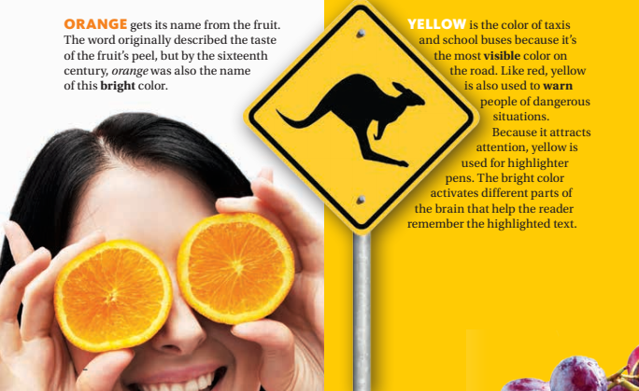
MATERIAL
Read the text carefully!

Slide 9
VOCABULARY
Good luck
Keberuntungan
Wedding
Pernikahan
Associate
Menghubungkan/Mangasosiasi
Danger
Bahaya
Emergency
Darurat
Adjective is a word which describes object (person, animal, thing, etc.
Can you find the example?
Colorblind
Buta warna
www.elearningsmp.sekolahsabilillah.sch.id

Slide 10
VOCABULARY
Originally
Aslinya
Bright
Cerah
Visible
Terlihat
Warn
Memperingatkan
Attract
Menarik
Adjective is a word which describes object (person, animal, thing, etc.
Can you find the example?
Attention
Perhatian
www.elearningsmp.sekolahsabilillah.sch.id

Slide 11
VOCABULARY
Common
Umum
Safety
Aman
Signal
Memberi tanda
Represent
Adjective is a word which describes object (person, animal, thing, etc.
Can you find the example?
Mewakili
Advertisement
Iklan
Trust
Percaya
www.elearningsmp.sekolahsabilillah.sch.id

Slide 12
VOCABULARY
Luxury
Kemewahan
Dye
Pewarna
Adjective is a word which describes object (person, animal, thing, etc.
Can you find the example?
Rare
Langka/jarang
Expensive
Mahal
Cave Painting
Lukisan di dinding gua
Death
Kematian
www.elearningsmp.sekolahsabilillah.sch.id

Slide 13
Question
What is your favorite color?
Why do you like it?
What does the color represent?
Do you agree with the explanation on the text? Explain your answer!
According to you, how does the color affect your mood?
www.elearningsmp.sekolahsabilillah.sch.id
Notes:
http://dotcolon.net/font/route159/
https://www.google.com/fonts/specimen/Open+Sans

Slide 14
EVALUATION
Log-in
Find the course
Log-in to e-learning using your NIS .
Type We Can Speak VIII on Cari Kursus. Choose topic: Unit 1- Color Matters
Do the Exercise
Submit
elearningsmp.sekolahsabilillah.sch.id
Read the instruction and do the exercise seriously.
Re-check your answer then when you have done, submit your answer.
You can access the evaluation or exercise through the e-learning of SMP Islam Sabilillah Malang.
The exercise will be provided there.
Good Luck
www.elearningsmp.sekolahsabilillah.sch.id

Slide 15
Thank You for Watching!
Any Questions?
www.elearningsmp.sekolahsabilillah.sch.id

