Slide 1

READY

Slide 2


SMP ISLAM SABILILLAH MALANG
Jln Terusan Piranha Atas No 135 Malang
Media Pembelajaran Interaktif WCS
Color Matters
Kelas VIII
oleh: Chasanatun Mujrikhah
www.elearningsmp.sekolahsabilillah.sch.id

Slide 3




CONTENT
INTRODUCTION
COLOR MATTERS
BASIC COMPETENCE
LEARNING OBJECTIVES
MATERIAL
EVALUATION

Slide 4

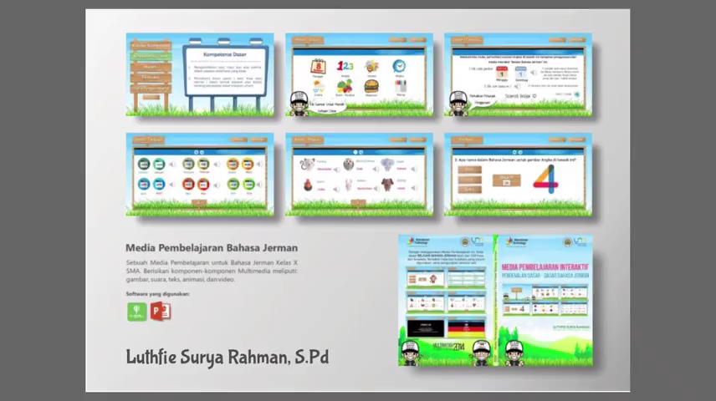



INTRODUCTION
Welcome to e-learning SMP Islam Sabilillah Malang. Through this e-learning we do hope we still can facilitate you to fulfil your hungry of knowledge and improve your speaking ability.
www.elearningsmp.sekolahsabilillah.sch.id

Slide 5


BASIC COMPETENCE
3.5 Mengidentifikasi fungsi sosial, struktur teks, dan unsur kebahasaan teks interaksi transaksional lisan dan tulis yang melibatkan tindakan memberi dan meminta informasi terkait dengan sifat orang, binatang, benda sesuai dengan konteks penggunaannya (Perhatikan unsur kebahasaan be, adjective)
3.7 Membandingkan fungsi sosial, struktur teks, dan unsur kebahasaan beberapa teks deskriptif lisan dan tulis dengan memberi dan meminta informasi terkait dengan deskripsi orang, binatang, dan benda sangat pendek dan sederhana, sesuai dengan konteks penggunaannya
www.elearningsmp.sekolahsabilillah.sch.id

Slide 6
Learning Objectives
1
2
3
Students are able to analyze adjectives
Students are able to analyze comparative and superlative form
Students are able to use comparative and superlative to compare two or more things
www.elearningsmp.sekolahsabilillah.sch.id
Notes:
http://dotcolon.net/font/route159/
https://www.google.com/fonts/specimen/Open+Sans

Slide 7
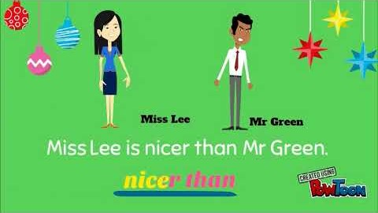
Warming Up
Let’s watch the video! Just click on it!
www.elearningsmp.sekolahsabilillah.sch.id

Slide 8
Warming Up Questions
1
2
3
What do you KNOW about Comparative and Superlative?
Can you provide the EXAMPLES?
What do you WANT to learn about Comparative and Superlative?
www.elearningsmp.sekolahsabilillah.sch.id

Slide 9

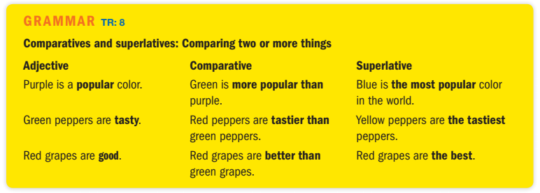

GRAMMAR FOCUS
lebih
paling
www.elearningsmp.sekolahsabilillah.sch.id

Slide 10
Degree of Comparison
GRAMMAR FOCUS
Three types of Degree of Comparison:
Positive Degree
Comparative Degree
Superlative Degree
www.elearningsmp.sekolahsabilillah.sch.id

Slide 11
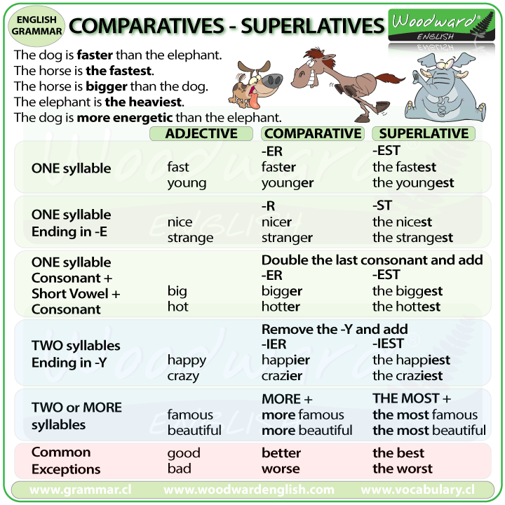
GRAMMAR FOCUS
high cheap young smart | small short old long
nice large wide | cute brave safe
big tall fat
busy noisy easy | dirty pretty lucky
beautiful handsome expensive popular | diligent luxurious interesting exciting
www.elearningsmp.sekolahsabilillah.sch.id

Slide 12
MORE EXAMPLE
Positive Adjective | Comparative | Superlative
Burj Khalifa is high | Burj Khalifa is higher than Eifel | Burj Khalifa is the highest building in the world
Katy’s house is large | Katy’s house is larger than my house | Katy’s house is the largest in our block
Bus is big | Bus is bigger than car | Bus is the biggest transportation of all
Monday is busy day | Monday is busier than Sunday | Monday is the busiest day of the week
Action movie is exciting | Action movie is more exciting than comedy | Action movie is the most exciting movie of all genres
My Math score is bad | My Math score is worse than my science score | My Math score is the worst from all lesson
www.elearningsmp.sekolahsabilillah.sch.id

Slide 13

Degree of Comparison
EVALUATION
Three types of Degree of Comparison:
Positive Degree
Comparative Degree
Superlative Degree
www.elearningsmp.sekolahsabilillah.sch.id

Slide 14





EVALUATION
Log-in
Find the course
Log-in to e-learning using your NIS .
Type We Can Speak VIII on Cari Kursus.
Do the Exercise
Submit
Read the instruction and do the exercise seriously.
Re-check your answer then when you have done, submit your answer.
You can access the evaluation or exercise through the e-learning of SMP Islam Sabilillah Malang.
The exercise will be provided there.
Good Luck
www.elearningsmp.sekolahsabilillah.sch.id

Slide 15
Thank You for Watching!
Any Questions?
www.elearningsmp.sekolahsabilillah.sch.id

