Slide 1
READY

Slide 2
SMP ISLAM SABILILLAH MALANG
Jln Terusan Piranha Atas No 135 Malang
Media Pembelajaran Interaktif WCS
Unit 1 : Color Matters (READING 2)
Kelas VIII
oleh: Chasanatun Mujrikhah
www.elearningsmp.sekolahsabilillah.sch.id

Slide 3
CONTENT
01
INTRODUCTION
04
MATERIAL
02
BASIC COMPETENCE
05
GAME
03
LEARNING OBJECTIVE
06
EVALUATION
www.elearningsmp.sekolahsabilillah.sch.id

Slide 4
Welcome!!
“
Welcome to e-learning SMP Islam Sabilillah Malang. Through this e-learning we do hope we can facilitate you to fulfil your
hungry of knowledge and improve your speaking ability from home.
“
www.elearningsmp.sekolahsabilillah.sch.id

Slide 5
BASIC COMPETENCE
3.5 Membandingkan fungsi sosial, struktur teks, dan
unsur kebahasaan teks interaksi transaksional lisan dan
tulis yang melibatkan tindakan memberi dan meminta
informasi terkait dengan sifat orang, binatang, benda
sesuai dengan konteks penggunaannya (Perhatikan
unsur kebahasaan be, adjective, degree of comparison)
4.5 Menyusun teks interaksi transaksional lisan dan tulis sangat
pendek dan sederhana yang melibatkan tindakan memberi dan
meminta informasi terkait sifat orang, binatang, dan benda, dengan memperhatikan fungsi sosial, struktur teks dan unsur kebahasaan yang benar dan sesuai konteks
www.elearningsmp.sekolahsabilillah.sch.id

Slide 6
Learning Objectives
1
2
3
Students are able to analyze
expressions for Correcting Information
Students are able to give
example expressions for
Correcting Information
Students are able to use
expressions of Correcting
Information in dialog
www.elearningsmp.sekolahsabilillah.sch.id
Notes:
http://dotcolon.net/font/route159/
https://www.google.com/fonts/specimen/Open+Sans

Slide 7
Warming Up Questions
01
When do you Correct information?
02
Why do you Correct Information?
03
How do you Correct Information?
04
What do you consider when you Correcting someone’s Information?
www.elearningsmp.sekolahsabilillah.sch.id

Slide 8
SPEAKING
www.elearningsmp.sekolahsabilillah.sch.id

Slide 9
Let’s LISTEN:
Prepare your notebook
Listen carefully
Write HOW DO THE SPEAKERS
CORRECT INFORMATION
Click
www.elearningsmp.sekolahsabilillah.sch.id

Slide 10
LET’S PLAY
1 | 2 | 3
4 | 5 | 6
Instruction:
Work in pair. Choose a box.
1 student will give information
and another one will
Correct Information about
what he/she said
www.elearningsmp.sekolahsabilillah.sch.id

Slide 11
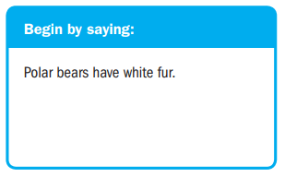

Slide 12
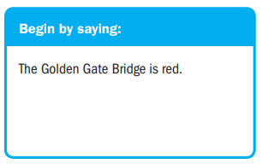

Slide 13
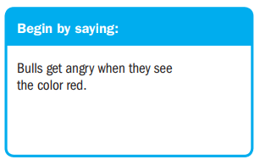
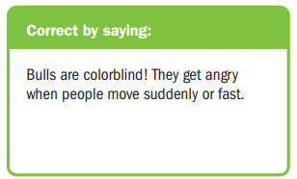

Slide 14
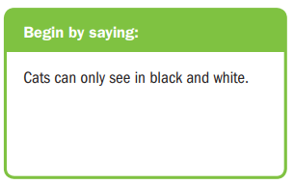
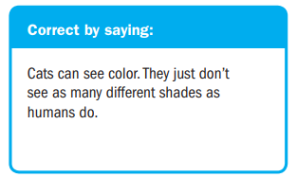

Slide 15
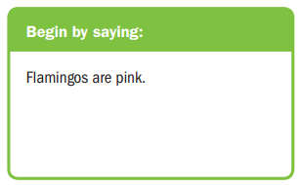
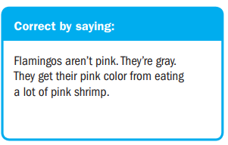

Slide 16
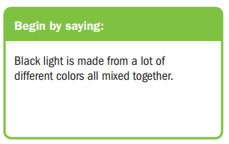
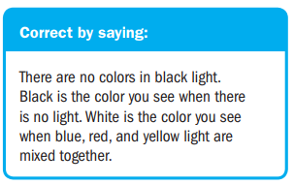

Slide 17
The Evaluation is provided in
Just login, find the quiz, and answer the
questions correctly.
GOOD LUCK
www.elearningsmp.sekolahsabilillah.sch.id

Slide 18
THANK YOU
www.elearningsmp.sekolahsabilillah.sch.id

