Slide 1

READY

Slide 2


SMP ISLAM SABILILLAH MALANG
Jln Terusan Piranha Atas No 135 Malang
Media Pembelajaran Interaktif WCS
Unit 1 : Color Matters (SPEAKING)
Kelas VIII
oleh: Chasanatun Mujrikhah
www.elearningsmp.sekolahsabilillah.sch.id

Slide 3


CONTENT
01
INTRODUCTION
02
BASIC COMPETENCE
03
LEARNING OBJECTIVE
04
MATERIAL
www.elearningsmp.sekolahsabilillah.sch.id

Slide 4
Welcome!!
“
Welcome to e-learning SMP Islam Sabilillah Malang. Through this e-learning we do hope we still can facilitate you to fulfil your
hungry of knowledge and improve your speaking ability.
“
www.elearningsmp.sekolahsabilillah.sch.id

Slide 5


BASIC COMPETENCE
3.5 Membandingkan fungsi sosial, struktur teks, dan
unsur kebahasaan teks interaksi transaksional lisan dan
tulis yang melibatkan tindakan memberi dan meminta
informasi terkait dengan sifat orang, binatang, benda
sesuai dengan konteks penggunaannya (Perhatikan
unsur kebahasaan be, adjective, degree of comparison)
4.5 Menyusun teks interaksi transaksional lisan dan tulis sangat pendek dan sederhana yang melibatkan tindakan memberi dan meminta informasi terkait sifat orang,
binatang, dan benda, dengan memperhatikan fungsi
sosial, struktur teks dan unsur kebahasaan yang benar
dan sesuai konteks
www.elearningsmp.sekolahsabilillah.sch.id

Slide 6
Learning Objectives
Students are able to analyze good paragraph
Add Contents Title
Add Contents Title
Students are able to make topic sentence
Students are to make descriptive text using topic sentence
Add Contents Title
www.elearningsmp.sekolahsabilillah.sch.id

Slide 7
Good Paragraph
time4writing.com
UNITY
COHERENCE
ORDER
COMPLETENESS
An pri splendide constituto. Ad animal noluisse voluptaria mei. Audire viderer sadipscing eam in, quo cu congue ubique interesset.
Sea autem salutandi maiestatis ex, dicta liberavisse in mel. Has fabulas mentitum facilisi et, nec quis nulla disputando ei. Vis eu scripta conclusionemque, ea lucilius sensibus per.
Te quo quas fierent detracto, vix rebum efficiendi ne. Ad vis affert sapientem. Officiis instructior no mei, usu inani legimus et. No duo nibh nusquam ocurreret, ut legere dictas corrumpit has, ei vel affert efficiantur.
Sea autem salutandi maiestatis ex, dicta liberavisse in mel. Has fabulas mentitum facilisi et, nec quis nulla disputando ei.
Vis eu scripta conclusionemque, ea lucilius sensibus per. Usu ad oblique labores, et vel mazim voluptaria.
www.elearningsmp.sekolahsabilillah.sch.id

Slide 8
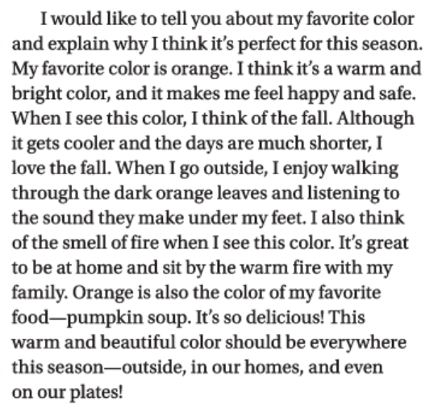
Read the paragraph carefully!
What the paragraph is about?
What do you think about the paragraph?
How does the writer describe his/her favorite color?
www.elearningsmp.sekolahsabilillah.sch.id

Slide 9
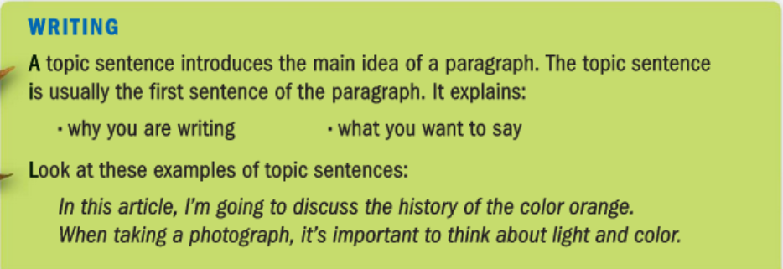
WRITING
www.elearningsmp.sekolahsabilillah.sch.id

Slide 10
What is the topic sentence?
Topic sentence
www.elearningsmp.sekolahsabilillah.sch.id

Slide 11
Thank you
Insert the title of your subtitle Here

