Slide 1
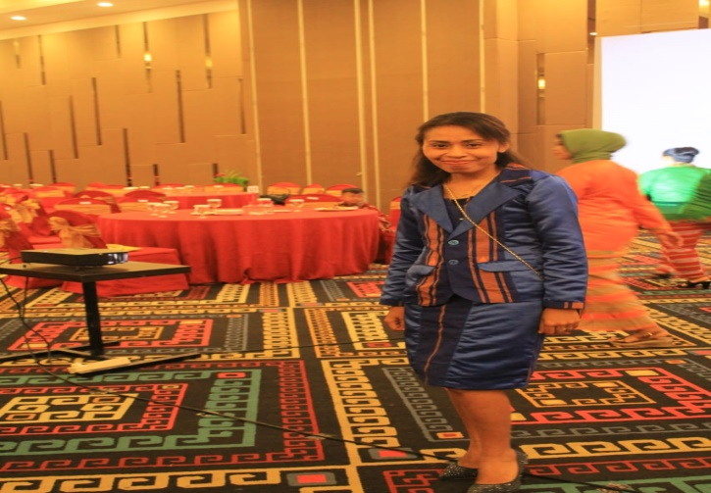
PEMBELAJARAN DARING BAHASA INGGRIS KELAS VII-SEMESTER GANJIL
Monday, August 9^{Th 2021}
29
Juli 2021
Meeting 1
1
Introducing Self/ Perkenalan Diri
2
Penyampaian Tujuan Pembelajaran
3
Pengenalan Materi

Slide 2
Opening pray
God ,Thank you for this beutiful day. Thank you for your blessing so that we can meet each other although via virtual meeting . Hopelly what we will learn we can receive it well. Bless all of us as the teacher and students. Thank you God, AMEN
In the name of the father, of the son, and of the holly spirit, amen(Khatolik)
Catatan : Muslim, Hindu, Budha dn protestan menyesusiakan dengan tata cara agamanya masing-masing.

Slide 3
Tujuan Pembelajaran
Memahami ungkapan yang digunakan untuk , Menyapa, berpamitan, berterimakasih, meminta maaf,
Menjelaskan fungsi social teks lisan dan tulis untuk Menyapa, berpamitan, berterimakasih, meminta maaf,
Meeting 2

Slide 4
MATERI
GREETING
INTRODUCING SLEF/OTHER PEOPLE
EXPRESSION
GRATITUDE
Expressing apology

Slide 5
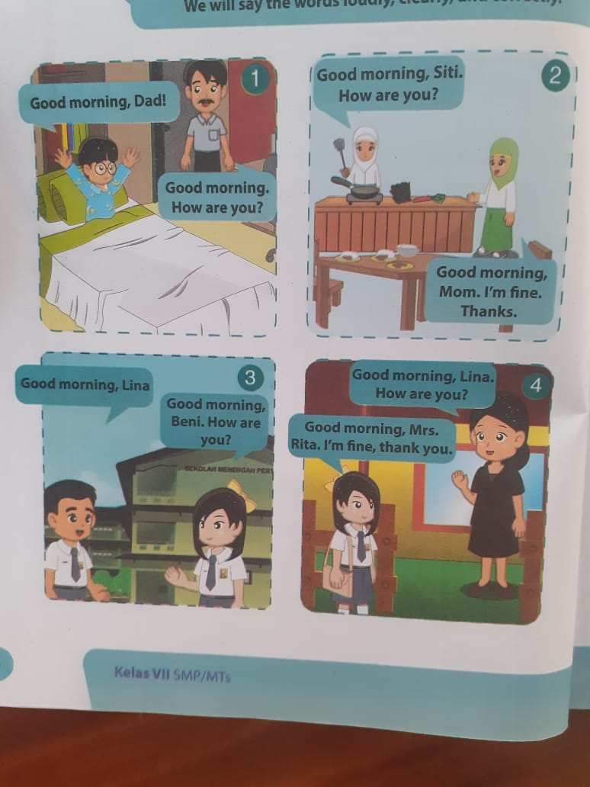
Greeting

Slide 6
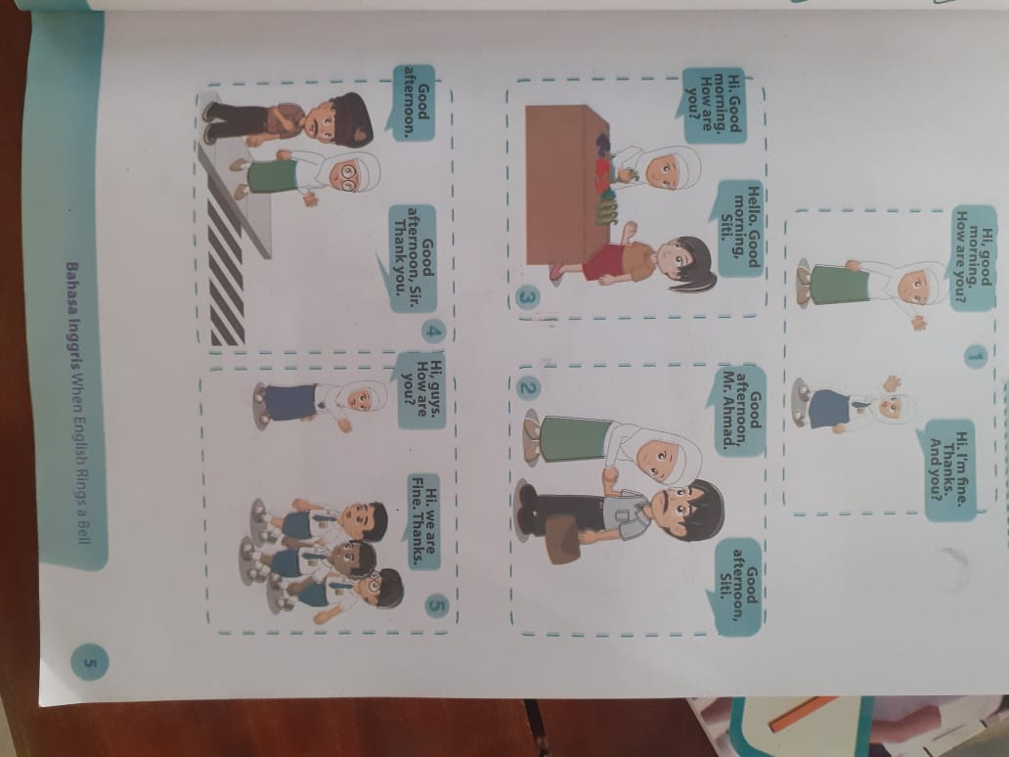
Lanjutan

Slide 7
Lanjutan

Slide 8
Lanjutan

Slide 9
Assignment

Slide 12
Assignment

Slide 13
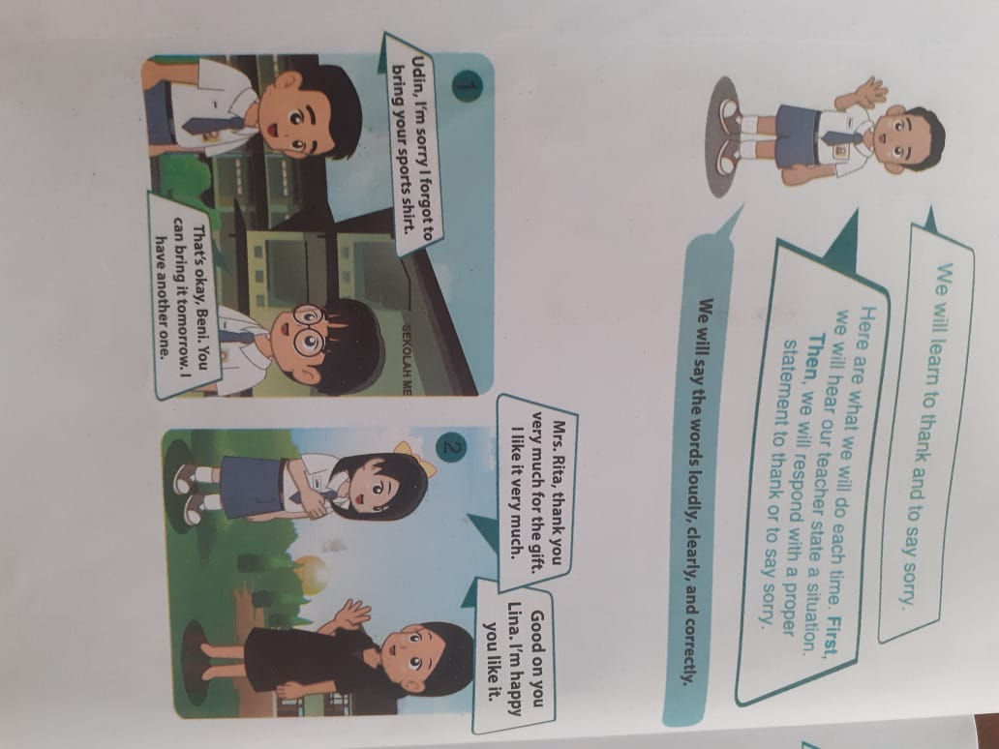

Slide 14
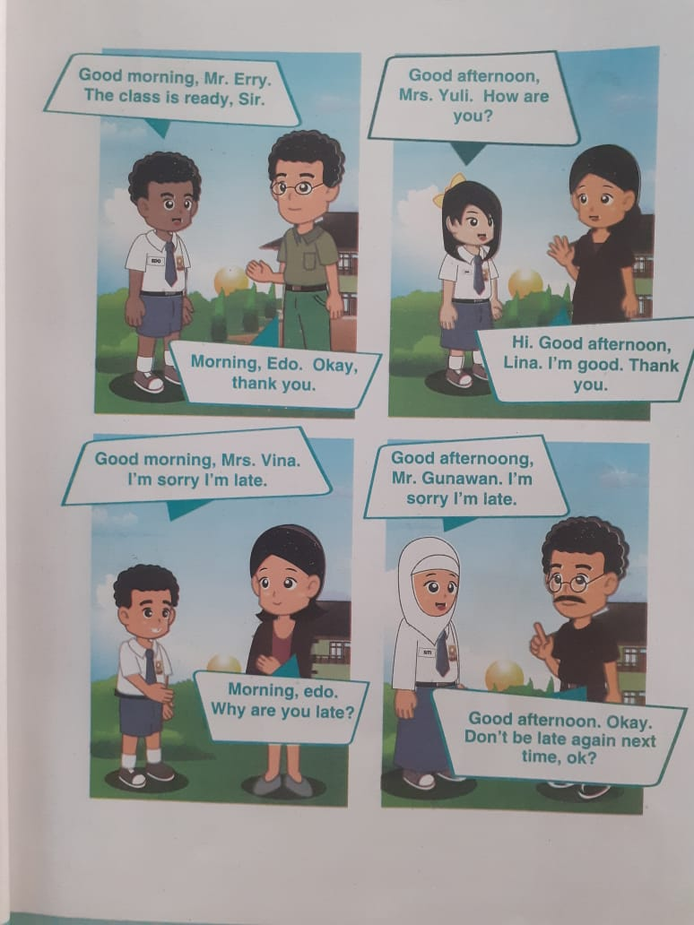

Slide 16
LINK ABSEN
https://forms.gle/2MeMxAx1kMpwDosq5

Slide 17
CLOSING pRAY
PRAY(Doa)
In the name of the father, of the son and of the holly spirit, amen(Khatolik)
God thank you for your blesiing today. Now, we have finish our study , please stay with us, so that we can continue our next lesson as well as, Amen
In the name of the father, of the son, and of the holly spirit, amen(Khatolik)
Catatan : Muslim, Hindu, Budha dn protestan menyesusiakan dengan tata cara agamanya masing-masing.

