Slide 1
For
SMP/MTs
Class VIII

Slide 2
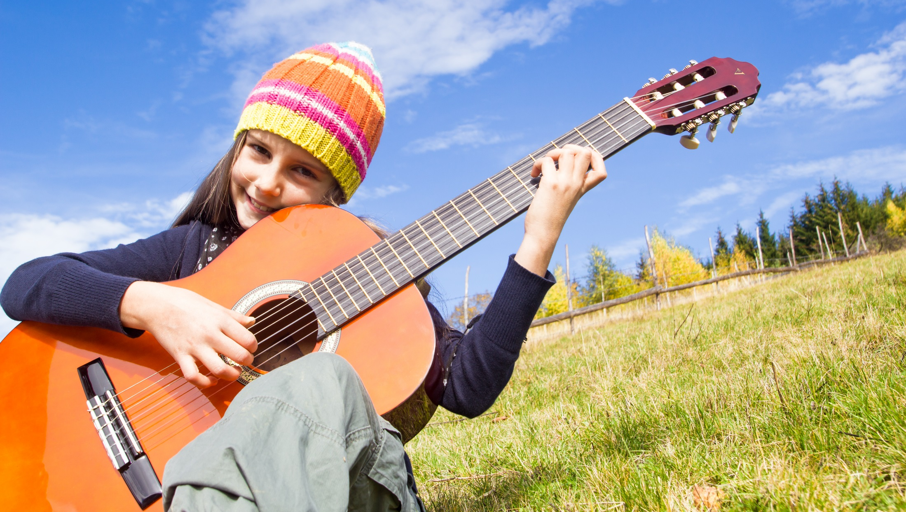
I Can Play the Guitar

Slide 3
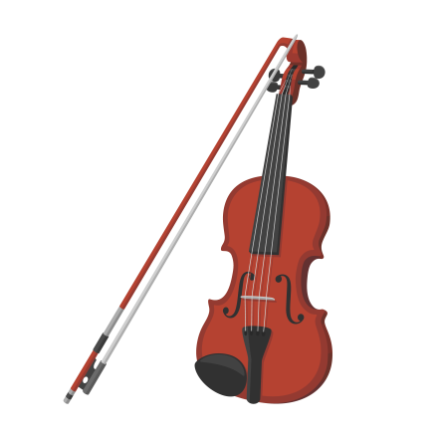
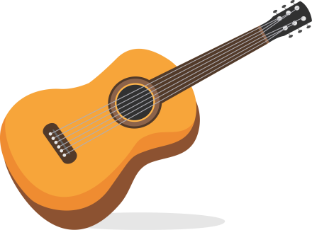
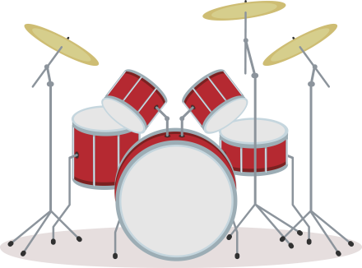
Can you play the guitar?
Say them.
guitar
keyboard
violin
drums

Slide 4
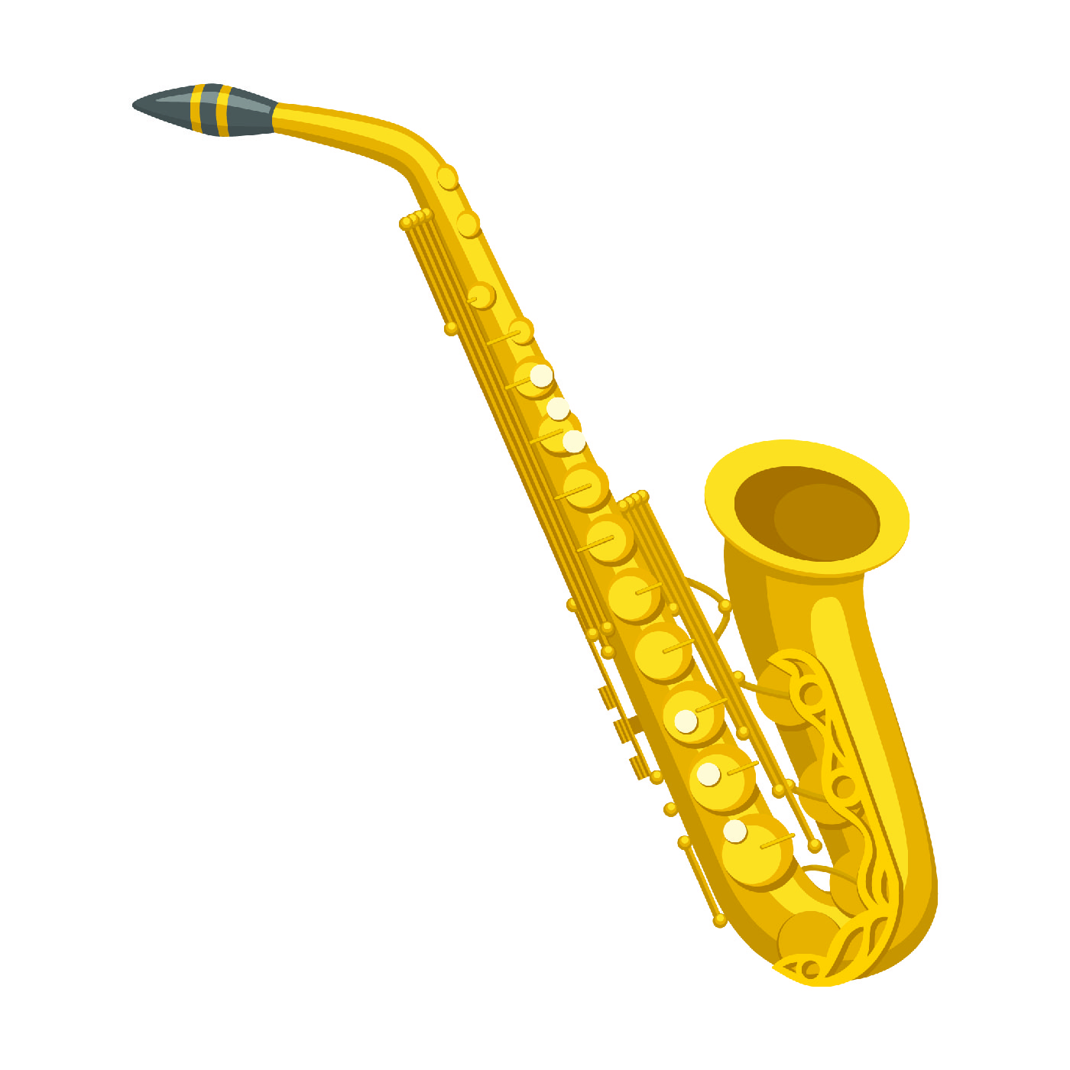
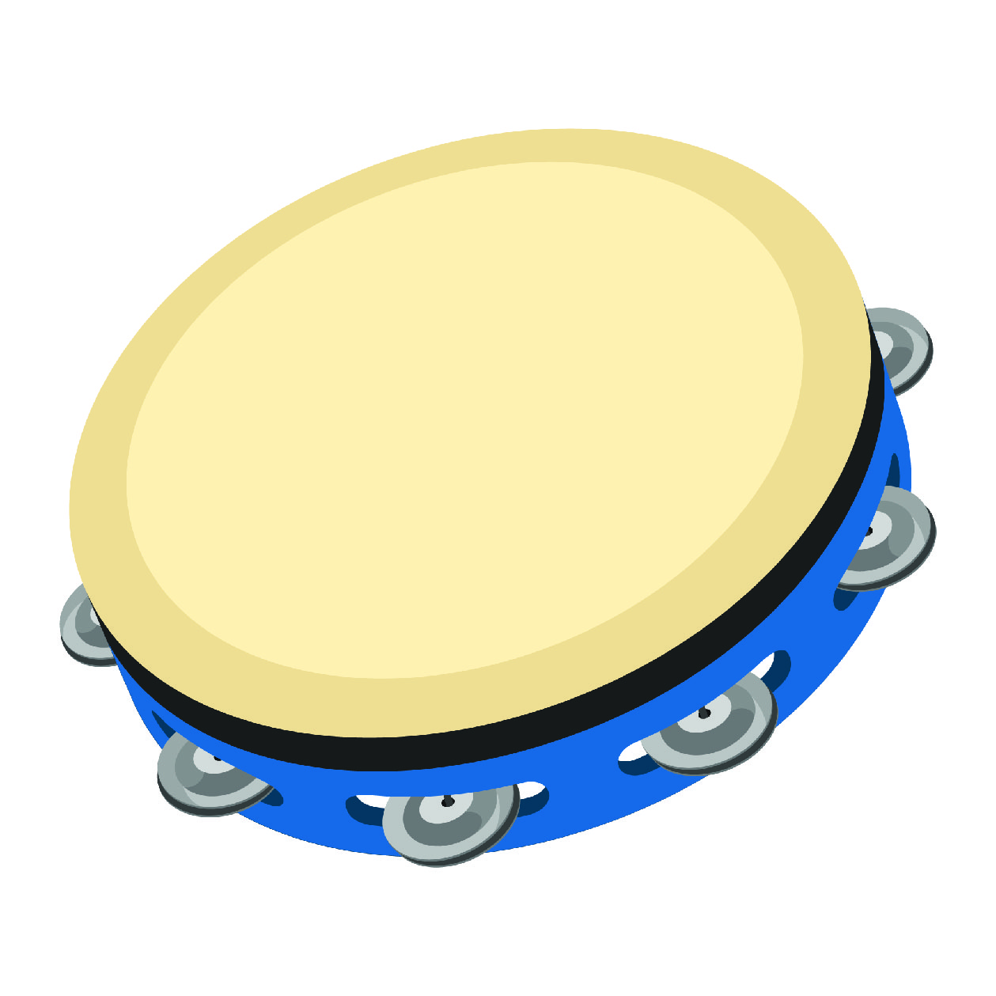
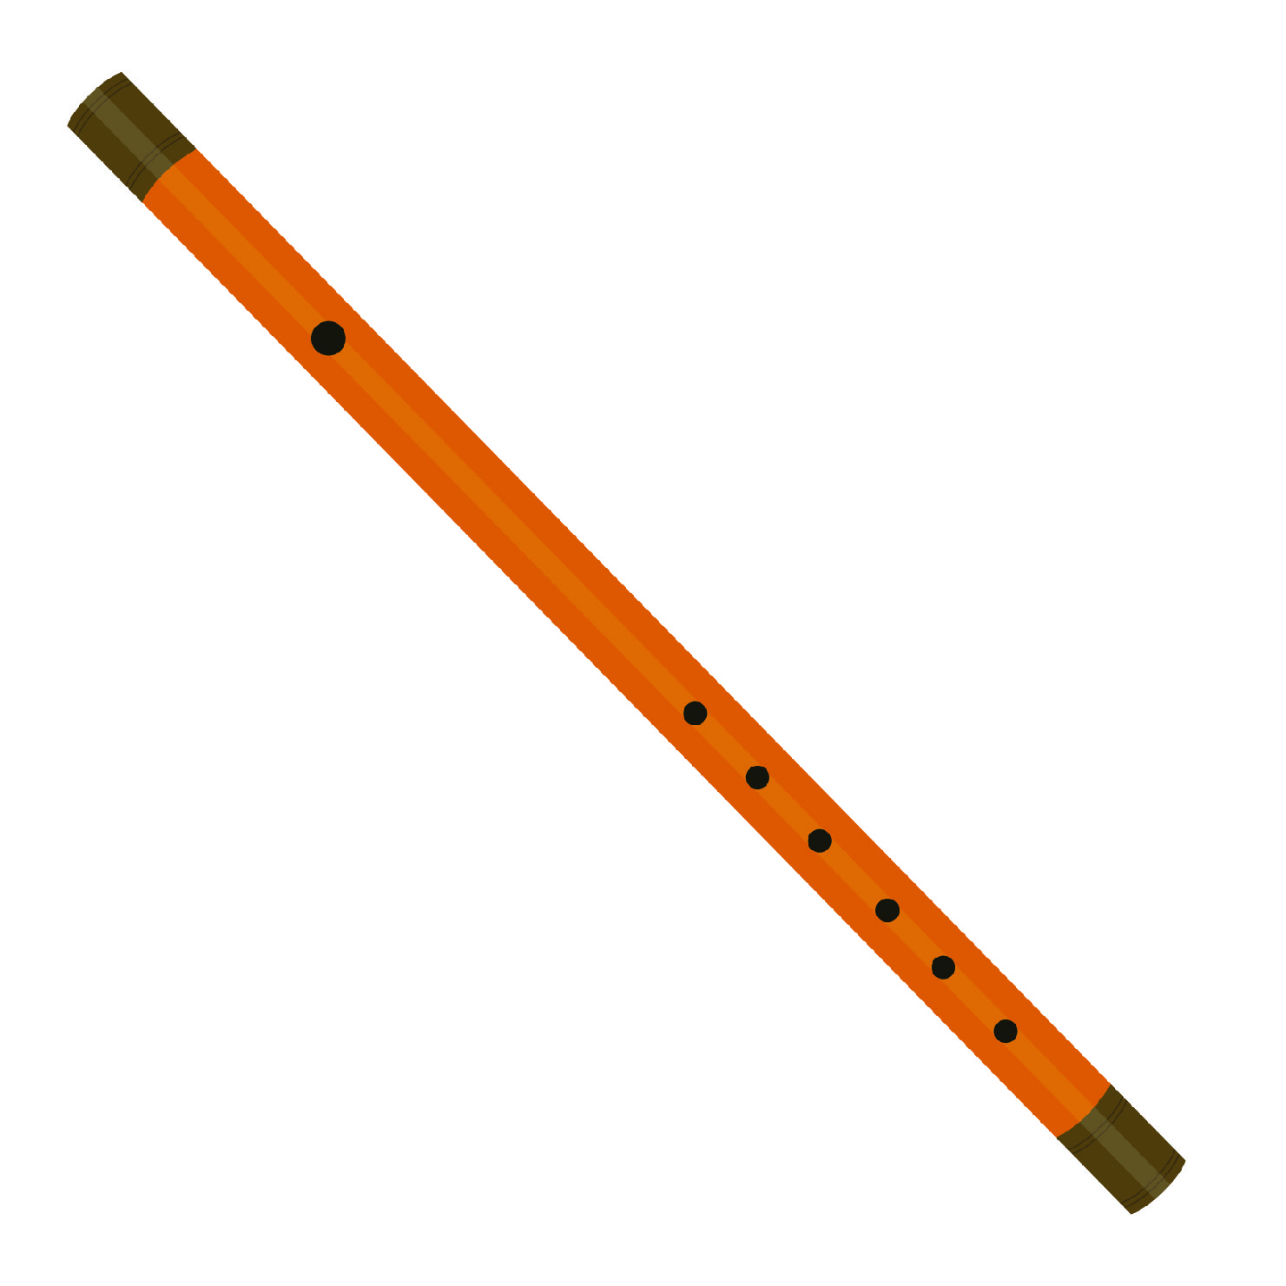
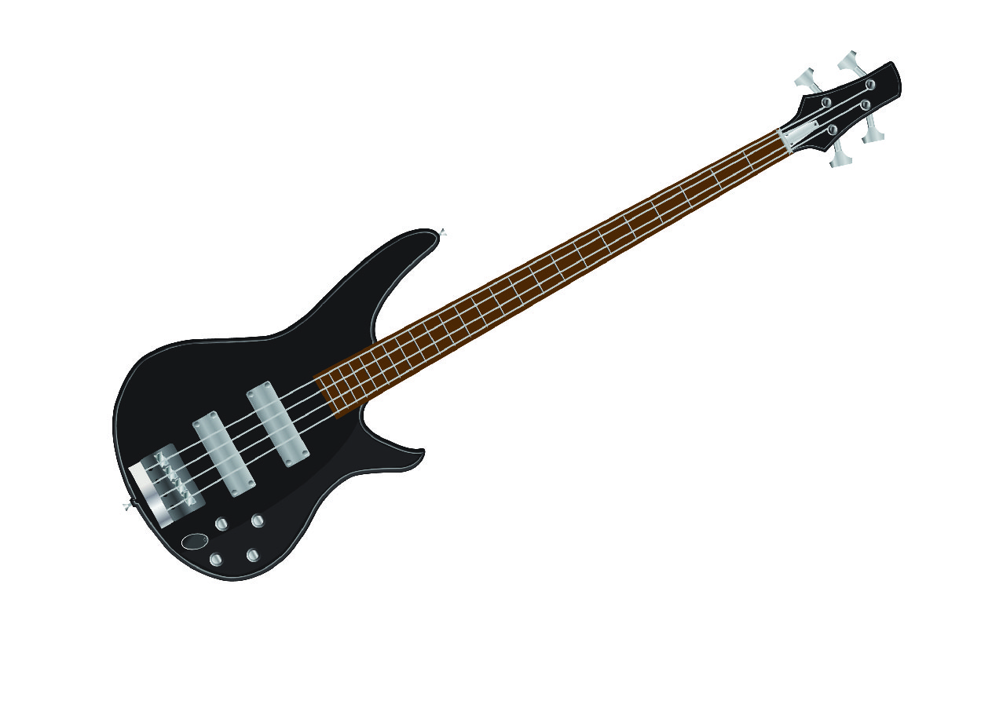
Say them.
flute
bass guitar
saxophone
tambourine

Slide 5
Practice the dialog.
Irma : What a nice guitar, Binsar.
Binsar : Thanks. It’s my brother’s.
Irma : Can you play it?
Binsar : Yes, but just a little. My brother can play it well.
Irma : Do you play any other musical instruments?

Slide 6
Cont.
Binsar : I can play the piano. What about you? Can you play the piano?
Irma : I can’t play the piano, but I can play the violin. Can you play the violin?
Binsar : No, I can’t.

Slide 7
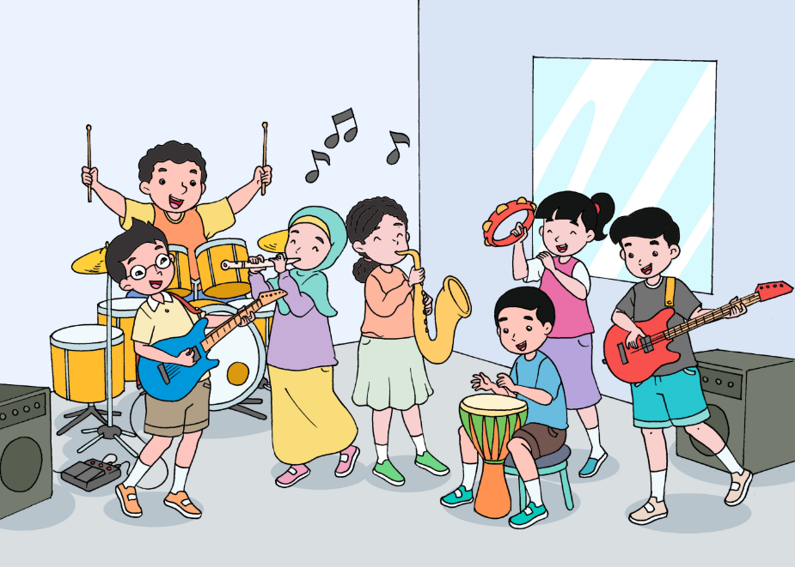
Think about it.
What do we say to tell people about our ability?
What do we say to tell people about our inability?
What do we say to know whether someone has the ability to play the guitar?

Slide 8
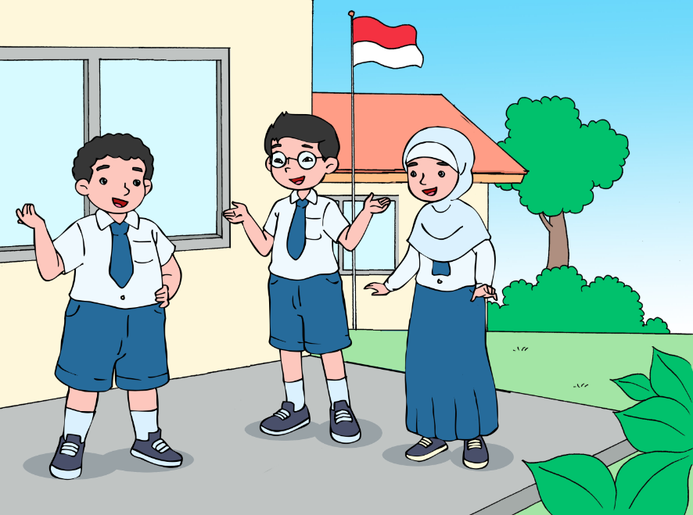
Act it out.
Make a group of three or four. Tell your friends in your group what musical instruments you can play.

Slide 9
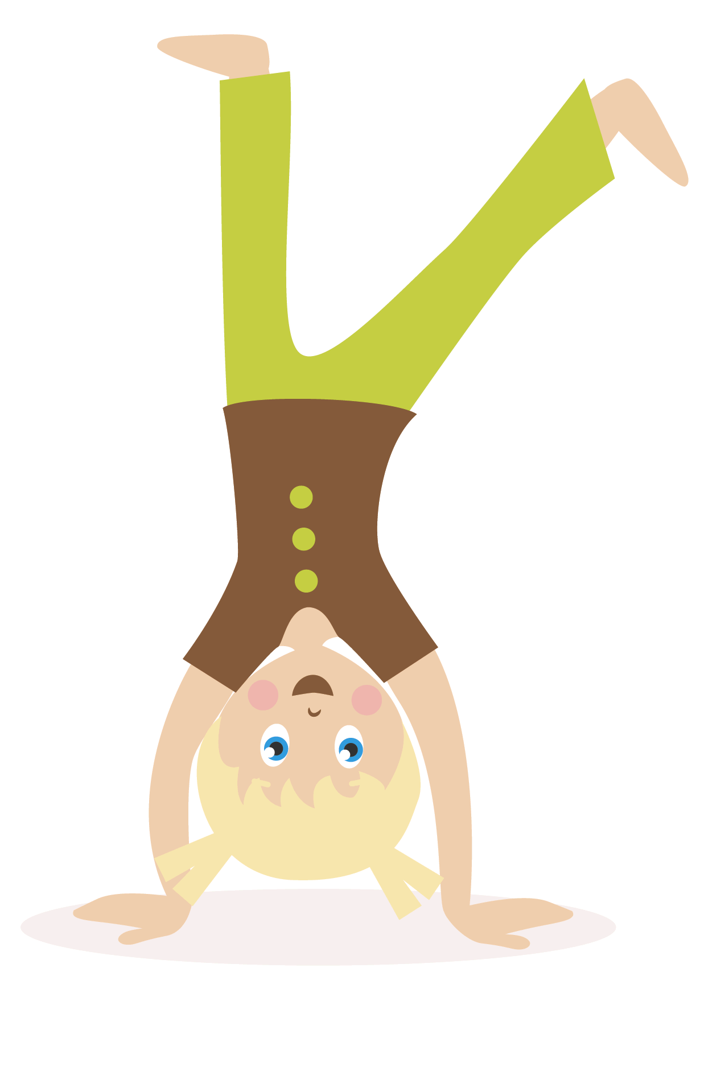
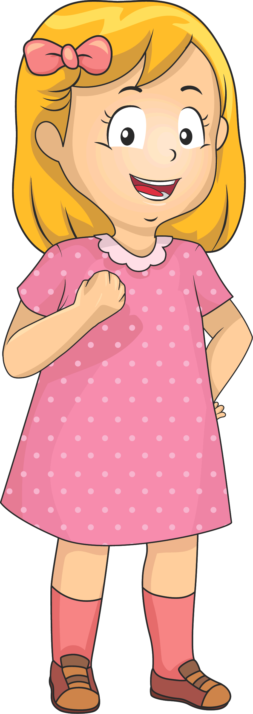
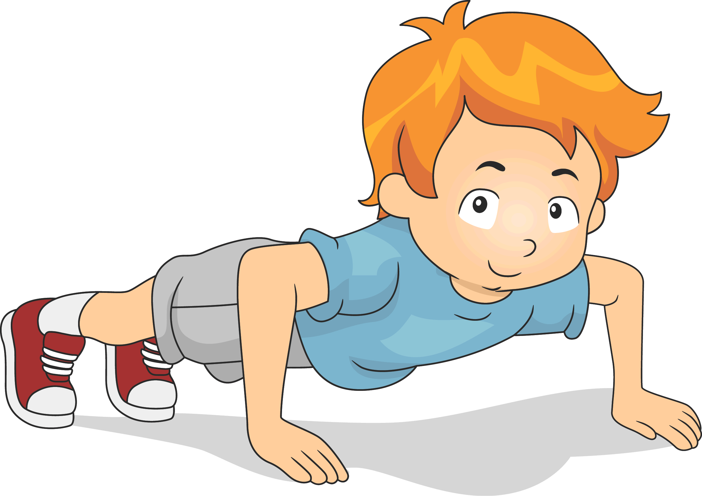
2. I can say the alphabet, but I can’t say it backward.
Say them.
Z, Y, X, W, ….
Say the alphabet backwards.
Do thirty push-ups.
Do a handstand.

Slide 10
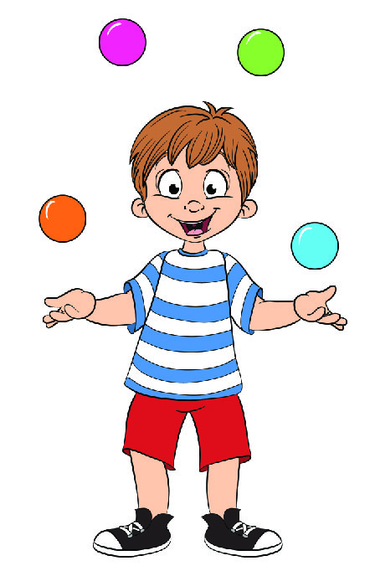
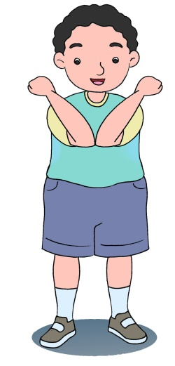
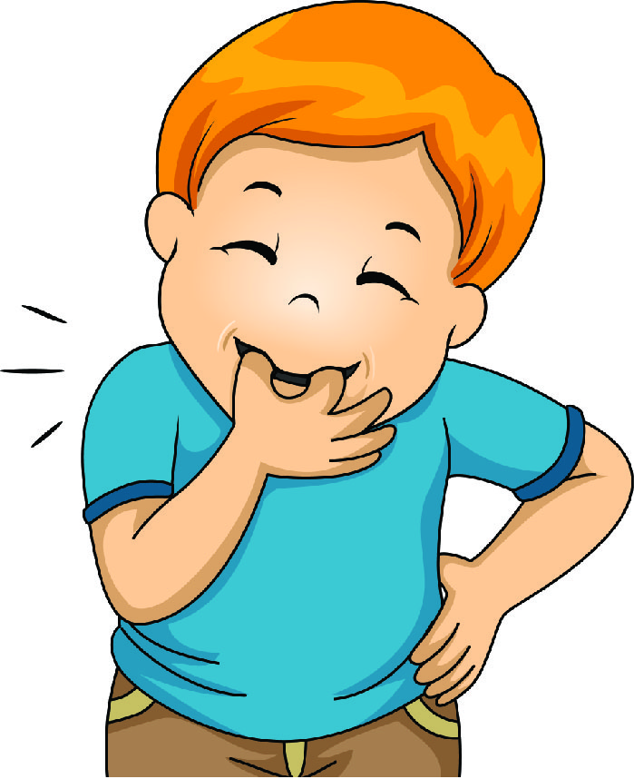
Say them.
Juggle four balls.
Touch elbows together.
Whistle

Slide 11
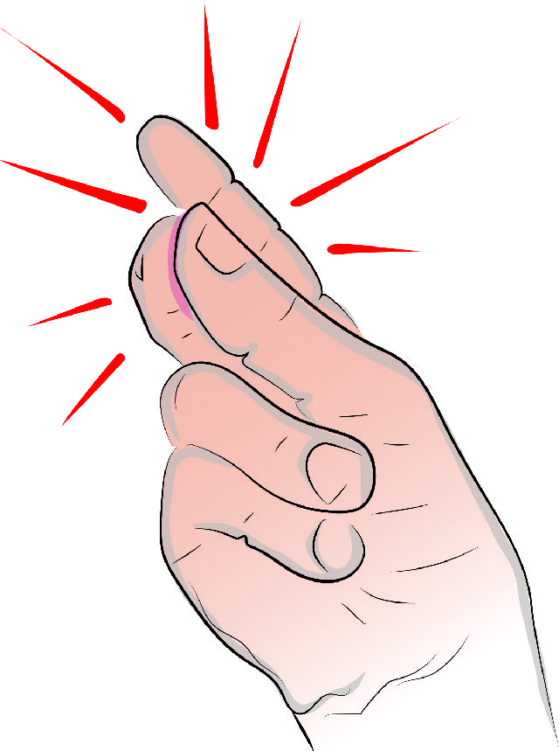
Say them.
I scream. You scream. We all scream for ice cream
Say, “I scream. You scream. We all scream for ice cream,” very fast.
Snap the fingers

Slide 12
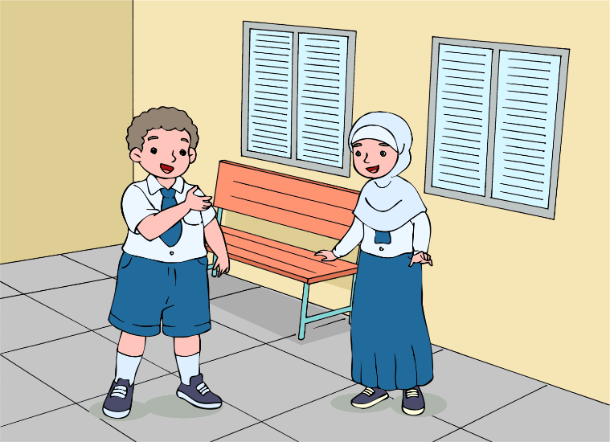
Practice the dialog.
Binsar : Can you snap your fingers?
Atiqah : Snap my fingers?
Binsar : Yes, like this. (snap… snap)
Atiqah : Let me try. Gee, I can’t. It doesn’t make any sound.
Binsar : What about this? Can you touch your elbows together?

Slide 13
Cont.
Atiqah : Let me give it a try. Well, that’s easy. What about you? Can you?
Binsar : Sure, I can.
Atiqah : Can you whistle? I can’t whistle.
Binsar : It’s a piece of cake.
Notes:
Beri animasi

Slide 14
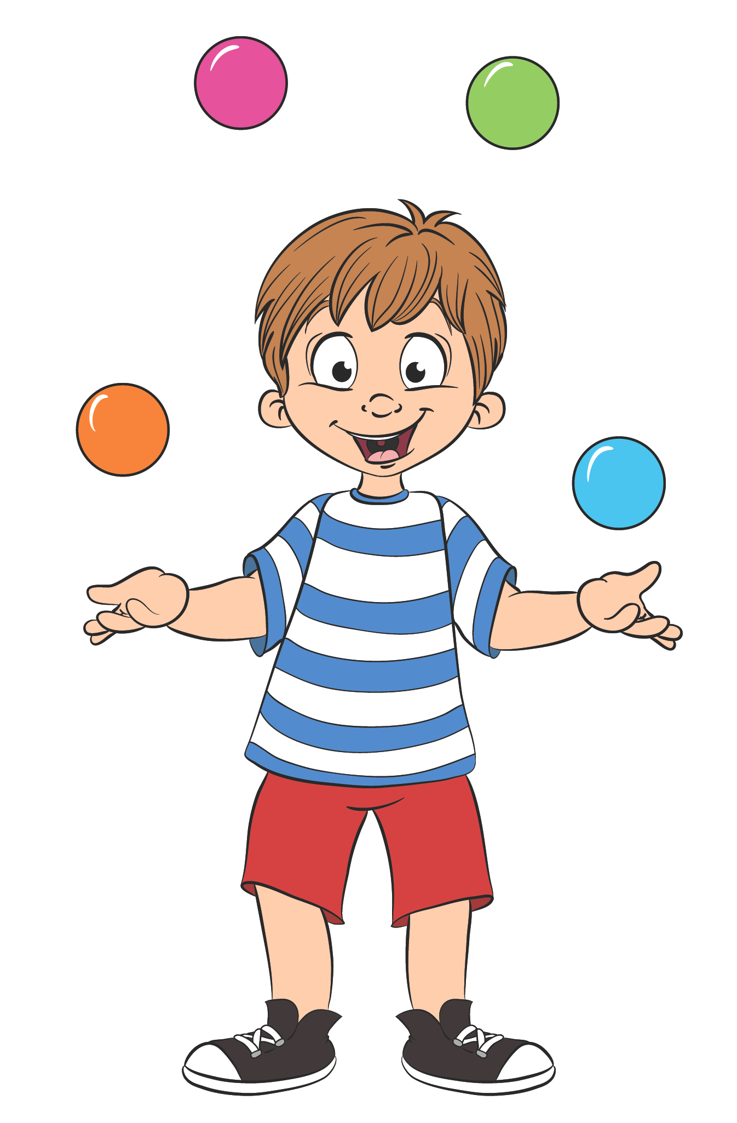
Think about it.
What do we ask when we want to know someone’s ability?
What is the best answer to can you juggle four balls?

Slide 15
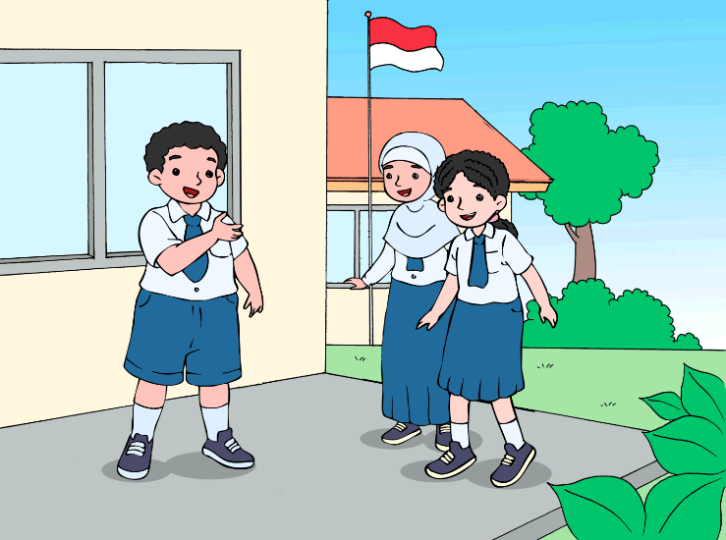
Class Survey
Think of one ability and ask all of your friends. Then report the result of the survey to the class.
Can you whistle?
Yes, sure I can.
Can you do a handstand?
No, I can’t

Slide 16
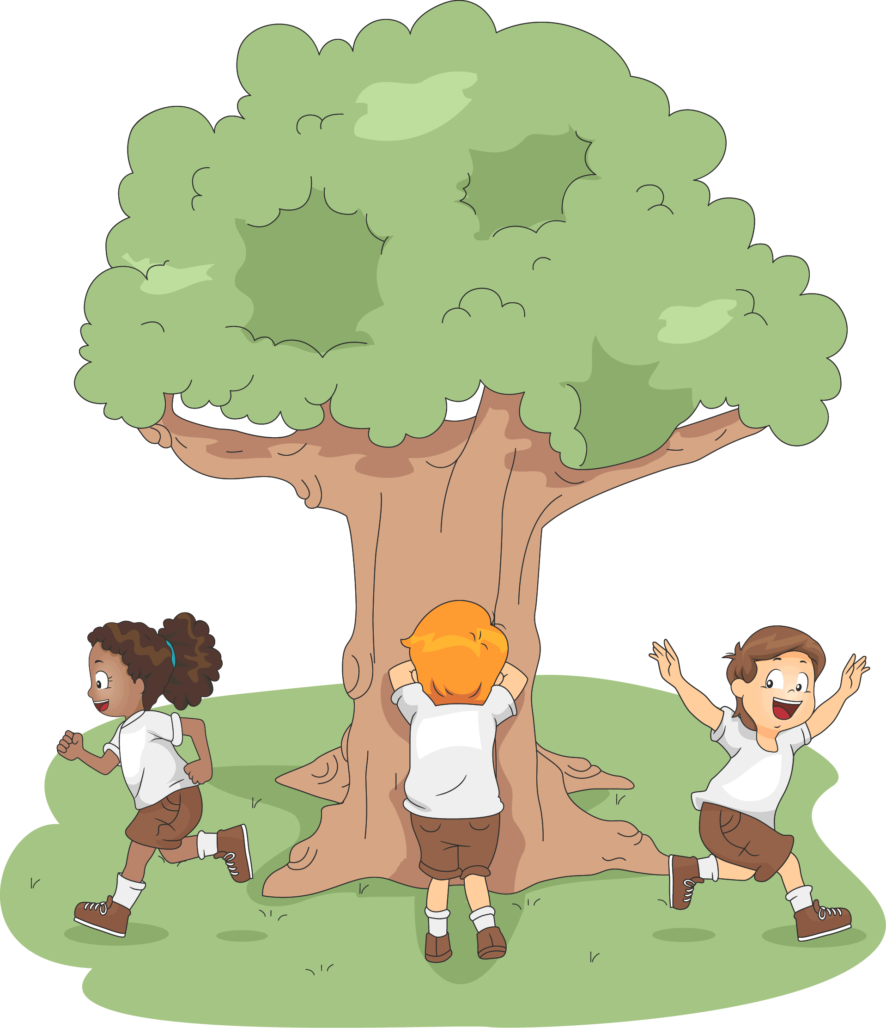
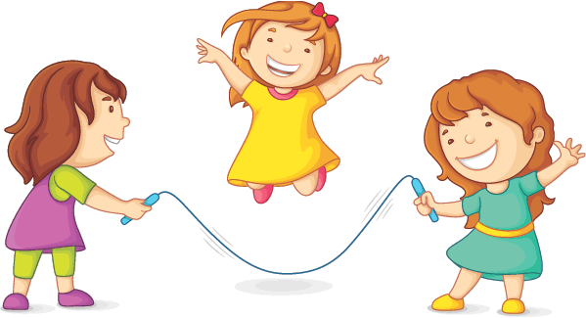
3. Can we do it together?
Say them.
hide and seek
jumping rope

Slide 17
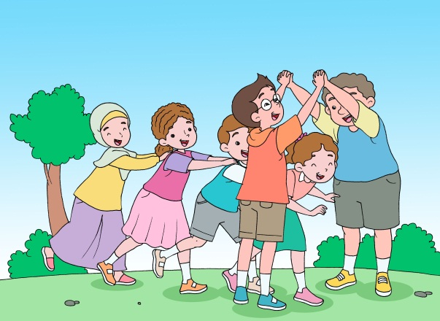
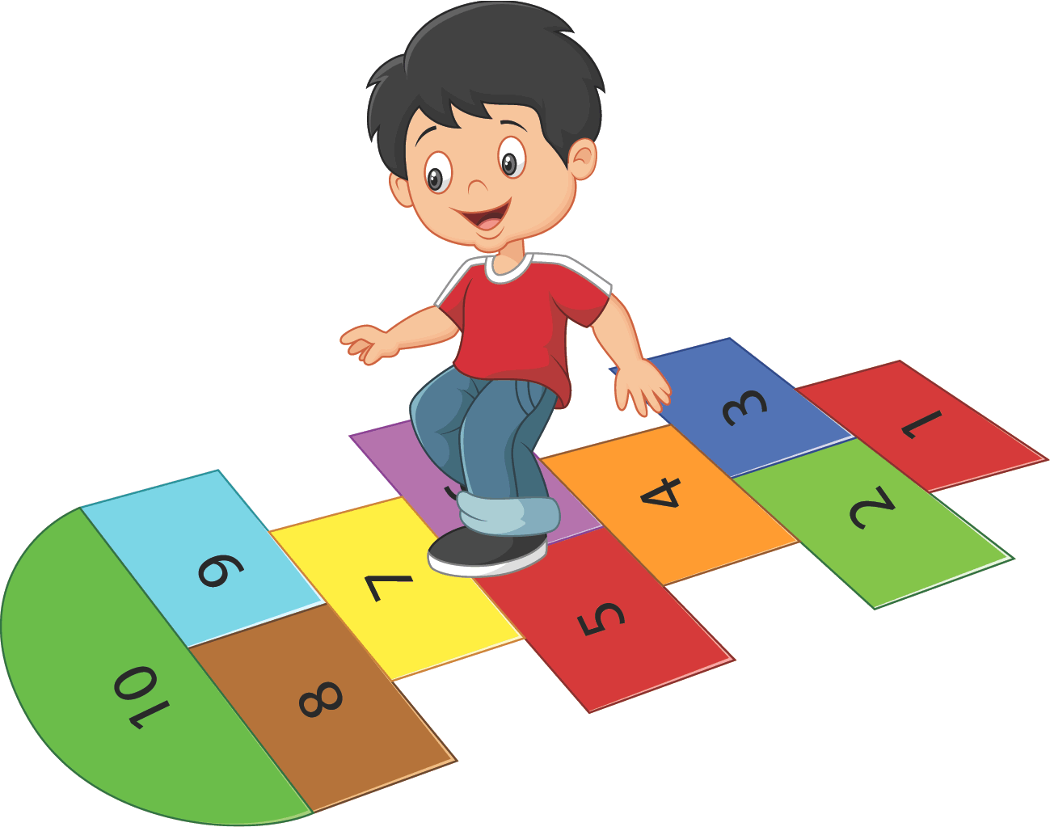
Say them.
oranges and lemons
hopscotch

Slide 18
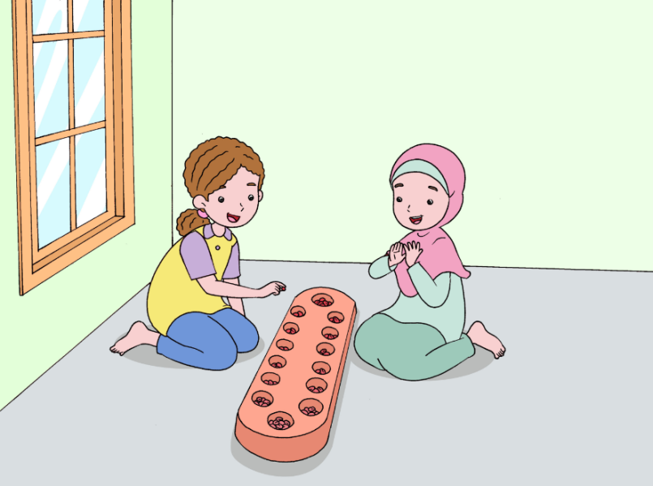
Practice the dialog.
Binsar : Hi, Thinneke. Can you play congklak?
Thinneke : Yes, I can. It’s very easy.
Binsar : Really?
Thinneke : Yes. Look at this picture. Easy, right?
Binsar : It looks easy. Can we try?
Thinneke : Okay.

Slide 19
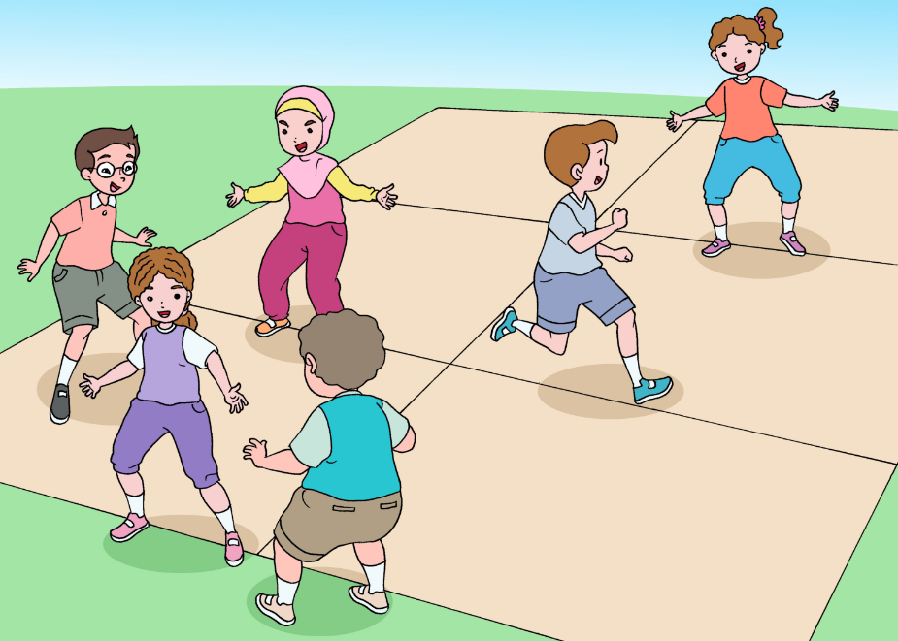
Practice the dialog.
Atiqah : Johan, can you play gobak sodor?
Johan : I can.
Atiqah : Good. Can we play it now?
Johan : I’m sorry I’m tired. Can we play something else?
Atiqah : How about playing congklak?
Johan : Okay. Let’s play it.

Slide 20
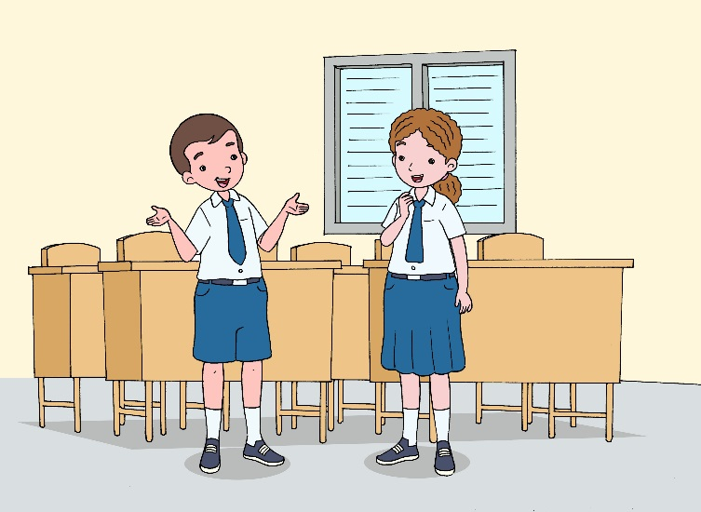
Think about it.
What do we say to invite someone to do things?
What is the best response to can we play congklak now?

Slide 21
Act it out.
Invite your friends to play a traditional game. Ask as many friends as possible. Report it to the class.
Can we play congklak?
Sure.
Sorry, I don’t like playing congklak.

Slide 22
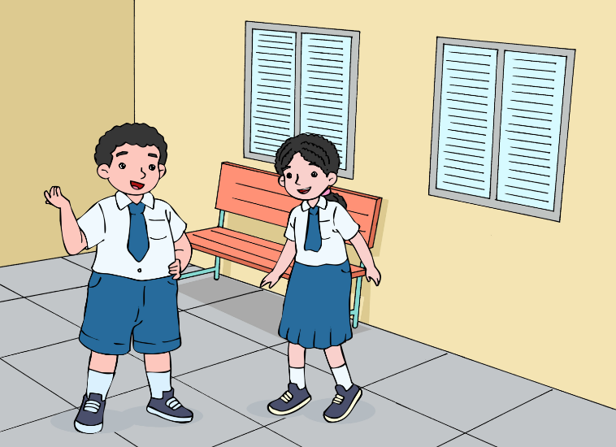
4. I’ll return it to the library.
Practice the dialog.
Binsar : Where are you going?
Thinneke : To the library. I need to borrow some books.
Binsar : Hey! Wait a second. Please do me a favor.
Thinneke : What is it?

Slide 23
Cont.
Binsar : I’m in a hurry. Can you please return this dictionary to the library?
Thinneke : OK. I’ll give it back to the library.
Binsar : Thank you.
Thinneke : Anytime.

Slide 24
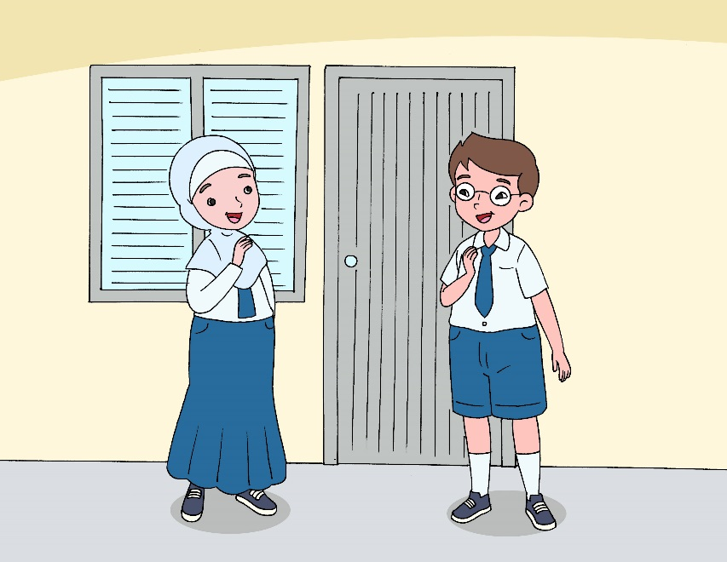
Think about it.
What do we say to express what we intend to do?
What is the best response to it is dark here?

Slide 25
Act it out.
See
page 37
for further instruction!
Work with a partner. You are student A and your friend is student B.

Slide 26
Summary
When we want to show one’s ability:
She can play the guitar.
When we want to know someone’s ability:
Can you say the alphabet backwards?
When we want to invite someone to do something:
Can we play “ular naga” now?
When we want to express what we intend to do:
I’ll turn on the lights.

