Slide 1
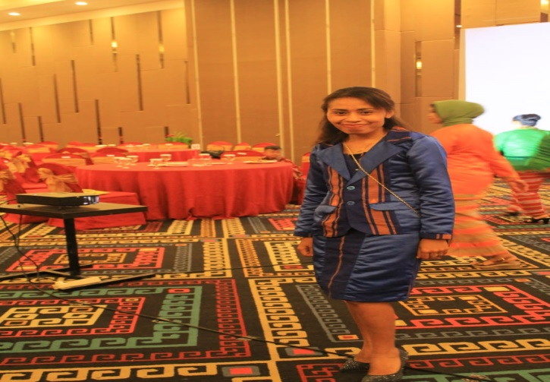
PEMBELAJARAN DARING ANGKASA KUPANG KELAS VII-SEMESTER GANJIL
2 Agustus 2021
Meeting 1
1
Introducing Self/ Perkenalan Diri
2
Penyampaian Tujuan Pembelajaran
Hello Everyone
My full name is Katharina Sanam
My Nick Name is Ketrin
I live in Naimata
Now, I teach in SDS ANGKASA AND SMP ANGKASA LANUD EL TARI KUPANG .Thank you
3
Pengenalan Materi

Slide 2
Opening pray
God ,Thank you for this beutiful day. Thank you for your blessing so that we can meet each other although via virtual meeting only. Hopelly what we will learn we can receive it as well as. Bless all of us as the teacher and as the students. Thank you God, AMEN
In the name of the father, andof the son, and of the holly spirit, amen(Khatolik)
Catatan : Muslim, Hindu, Budha dn protestan menyesusiakan dengan tata cara agamanya masing-masing.

Slide 3
Metode Pembelajaran
Whatsup, google form, google meet Daring(online) Kombinasi Luring(Ofline/Tatap Muka)
Scientific Aprpoach
MODEL PEMBELAJARAN
METODE
PENDEKATAN

Slide 4
MATERI

Slide 5
Lanjutan

Slide 7
SUMBER BELAJAR
DI DAPAT DARI :
YOUTUBE
HAND OUT GURU

Slide 8
MEDIA BELAJAR
HP
LAPTOP/KOMPUTER

Slide 9
CLOSING pRAY
PRAY(Doa)
In the name of the father, and of the son and of the holly spirit, amen(Khatolik)
God thank you for your blesiing today. Now, we have finish our study , please stay with us, so that we can continue our next lesson as well as, Amen
In the name of the father, of the son, and of the holly spirit, amen(Khatolik)
Catatan : Muslim, Hindu, Budha dn protestan menyesusiakan dengan tata cara agamanya masing-masing.

