Slide 1


PEMBELAJARAN DARING
BAHASA INGGRIS
KELAS VII-SEMESTER GANJIL
Monday, August 30^{Th 2021}
Penyampaian Tujuan Pembelajaran
Pengenalan Materi

Slide 2
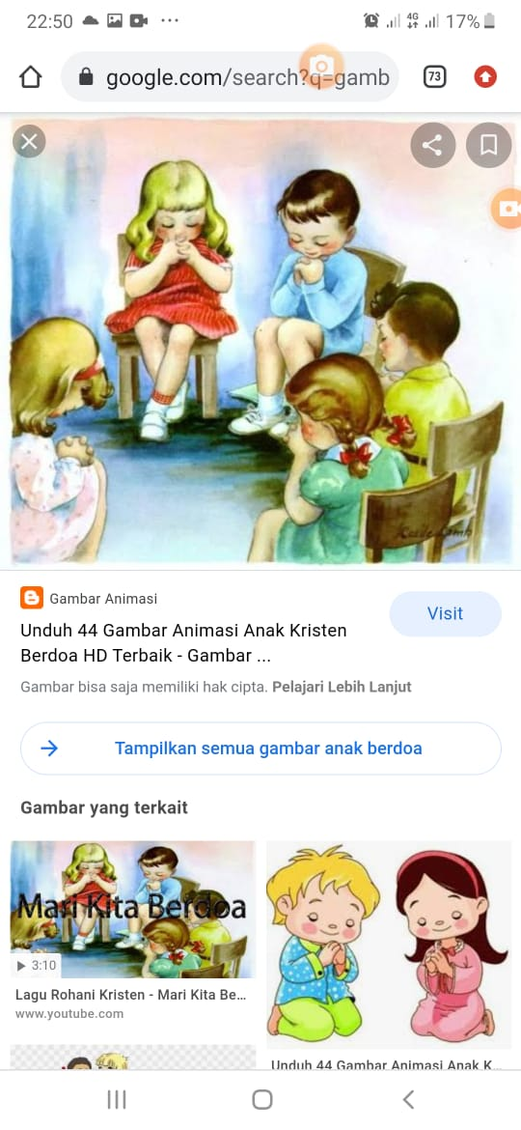
Opening pray
God ,Thank you for this beutiful day. Thank you for your blessing so that we can meet each other although via virtual meeting . Hopelly what we will learn we can receive it well. Bless all of us as the teacher and students. Thank you God, AMEN
In the name of the father, of the son, and of the holly spirit, amen(Khatolik)
Catatan : Muslim, Hindu, Budha dn protestan menyesusiakan dengan tata cara agamanya masing-masing.

Slide 3
Tujuan Pembelajaran
Memahami penggunaan cardinal number dan ordinal number
Melakukan tindak tutur penggunaan cardinal number dan ordinal number
Meeting 4

Slide 4
MATERI
Cardinal dan Ordinall number

Slide 5
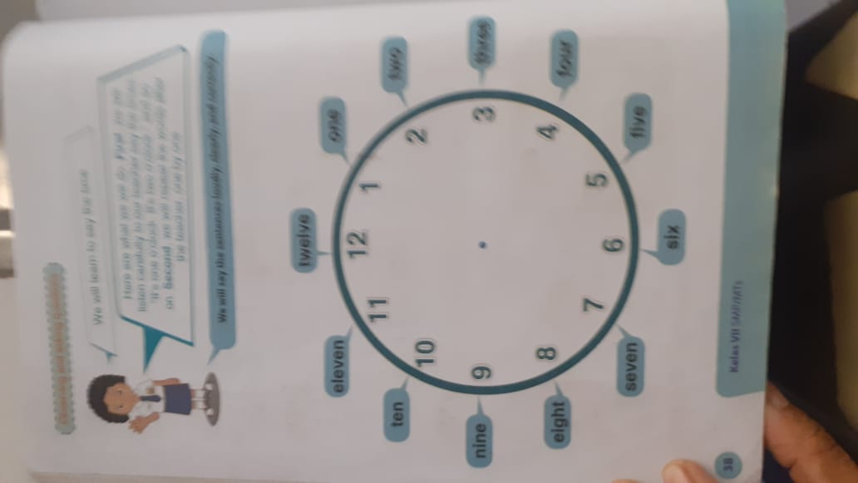
Ordinal dan Cardinal Number

Slide 6
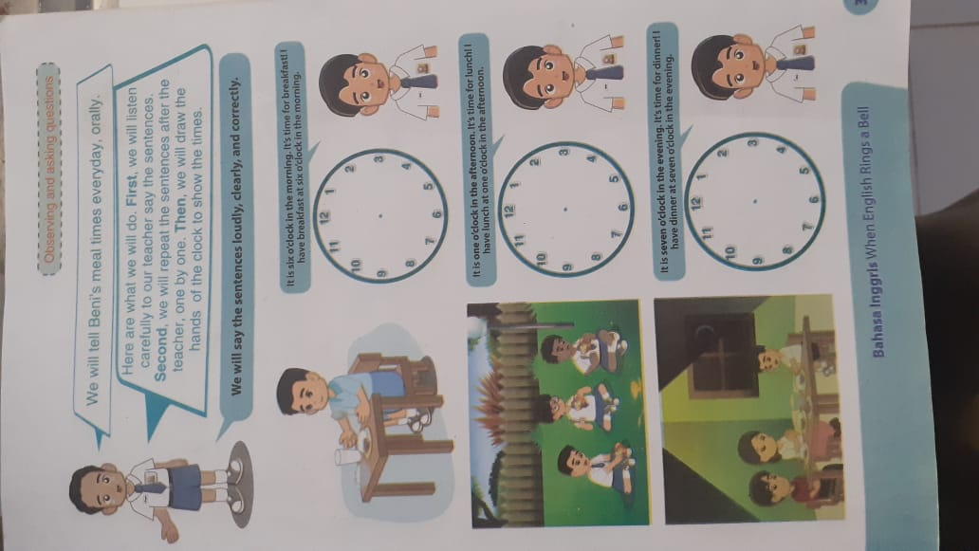
Lanjutan

Slide 7
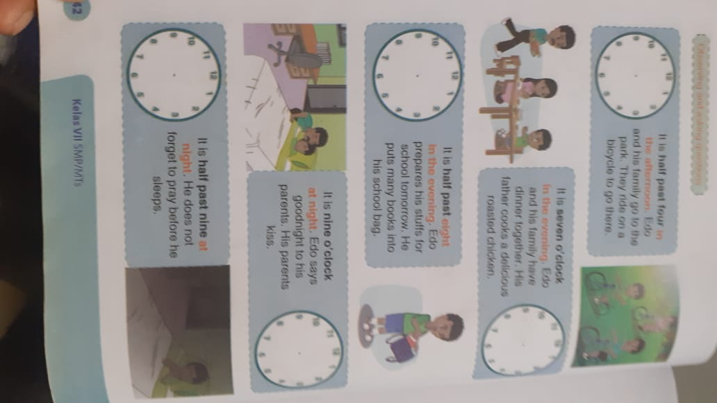
Lanjutan

Slide 8
Lanjutan

Slide 9
CLOSING pRAY
PRAY(Doa)
In the name of the father, of the son and of the holly spirit, amen(Khatolik)
God thank you for your blesiing today. Now, we have finish our study , please stay with us, so that we can continue our next lesson as well as, Amen
In the name of the father, of the son, and of the holly spirit, amen(Khatolik)
Catatan : Muslim, Hindu, Budha dn protestan menyesusiakan dengan tata cara agamanya masing-masing.

Slide 10


