Slide 1



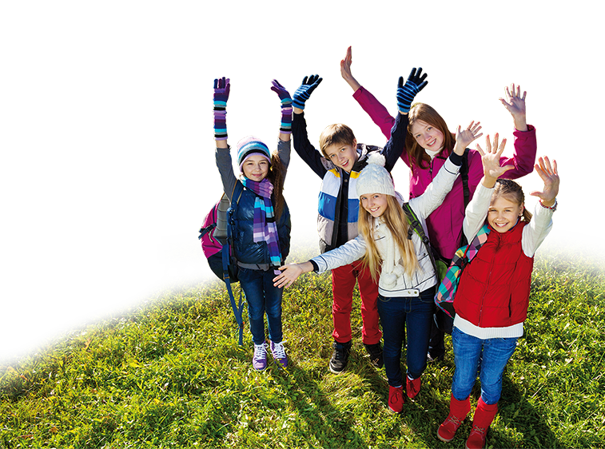

For
SMP/MTs
Class VII

Slide 2
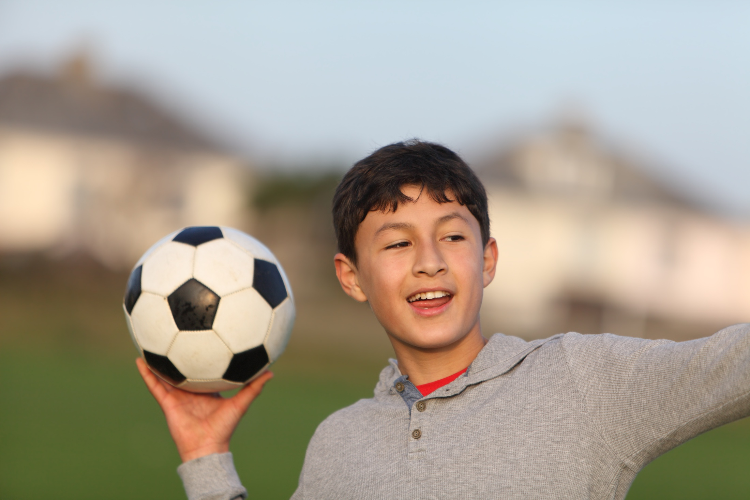


He Has Straight Dark Hair

Slide 3
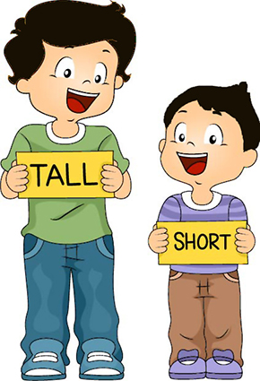
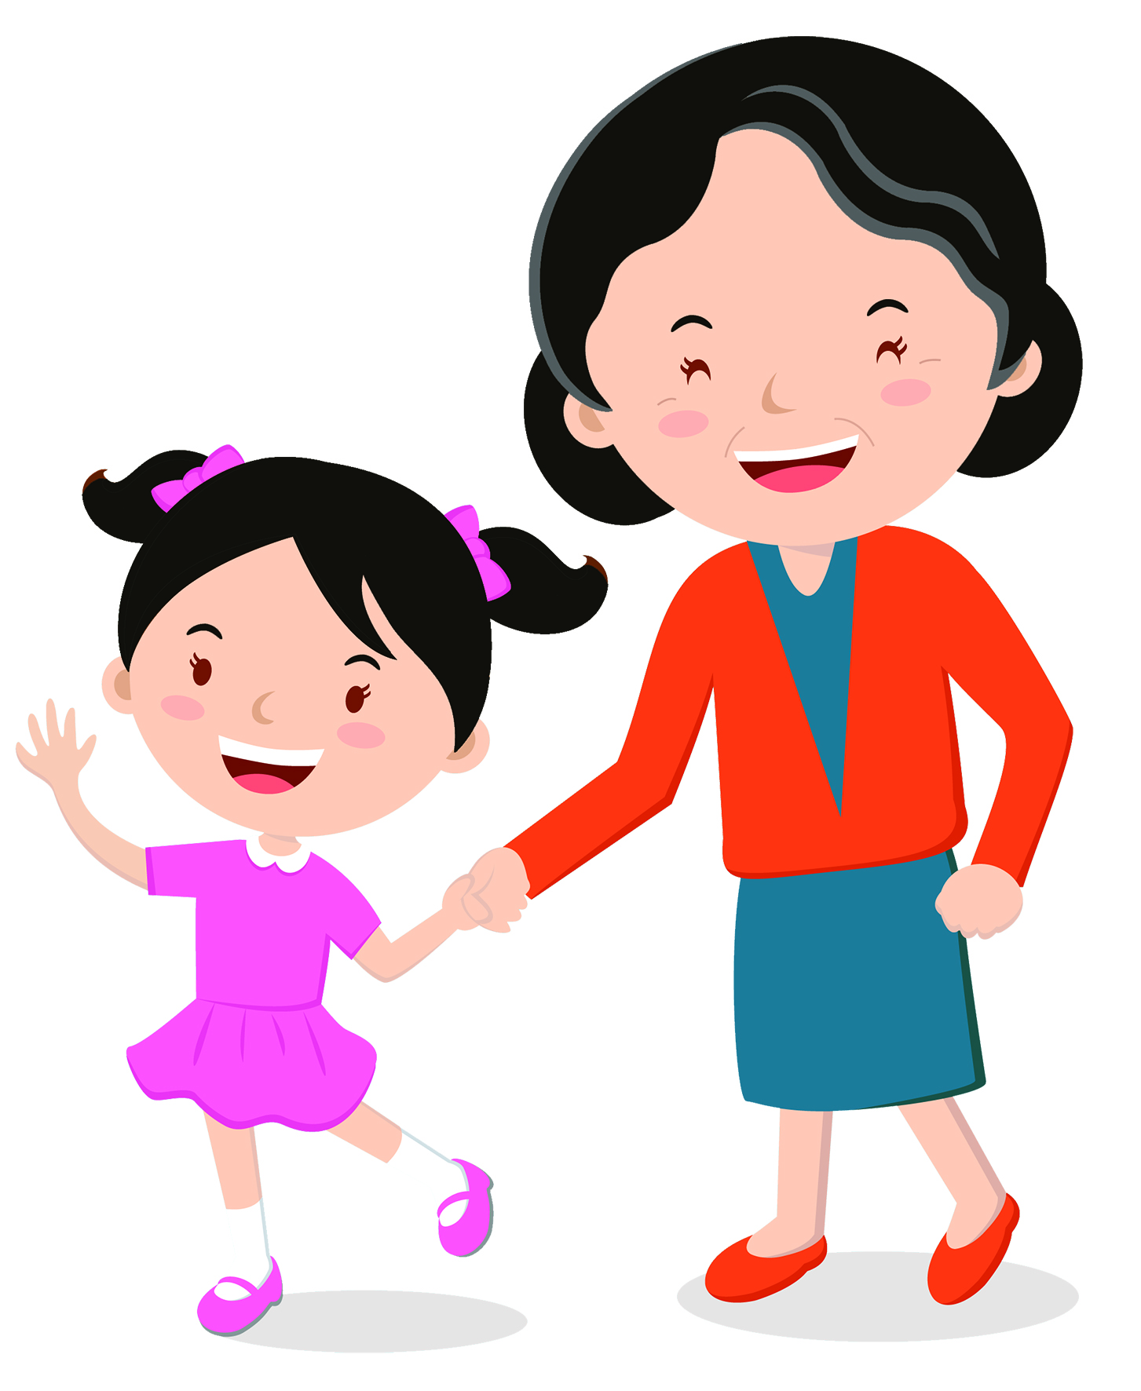
1. What does your brother look like?
Say them.
Anton is tall and Dino is short.
Mira is young and Mrs. Hera is old.

Slide 4

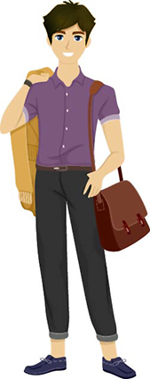
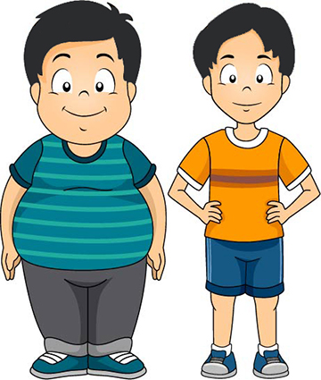
Say them.
Dana is beautiful and Harry is handsome.
Rio is thin and Hasan is chubby.

Slide 5
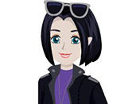

Say them.
She has short straight hair.
She has long wavy hair.

Slide 6
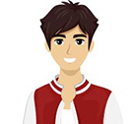
Say them.
He has a round face.
He has an oval face.

Slide 7
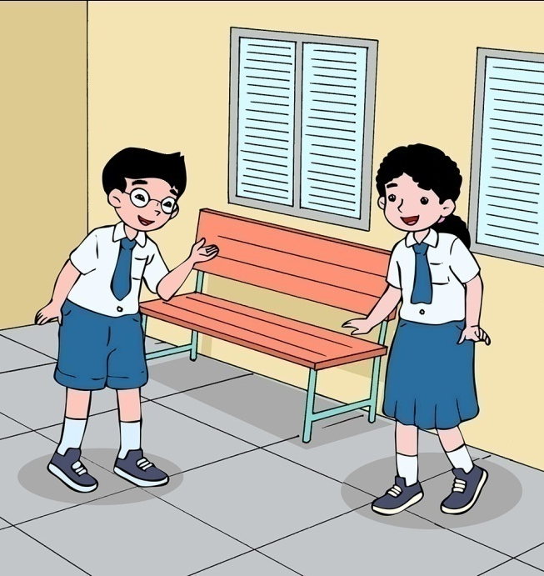
Practice the dialog.
Johan : Hey, Thinneke. Would you like to meet my brother?
Thinneke : Your brother? What does he look like?
Johan : Well. He’s tall and slim. He has straight dark hair.
Thinneke : Is he good looking?
Johan : Of course, he is. He’s my brother, you know.

Slide 8
Make it real.
I’m proud of my mother.
What does she look like?
Work with your friend. Think of a ember of your family whom you are proud of. Talk about her or him.
She is tall. She has long dark hair and an oval face.

Slide 9
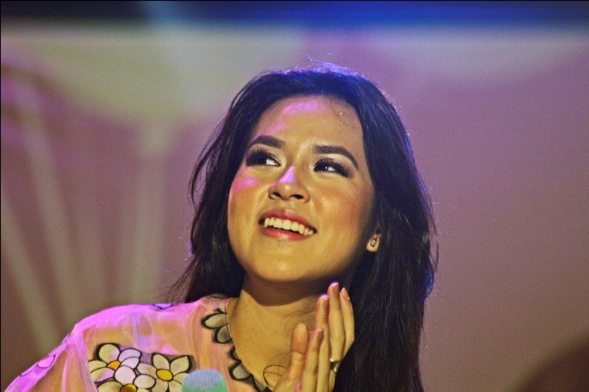
2. Raisa is a talented singer and songwriter.
Read aloud.
I really like Raisa. She’s a talented singer and songwriter. She is also a creative person. She writes some songs for her album. She has long wavy hair and a pointed nose. I think she’s beautiful.

Slide 10
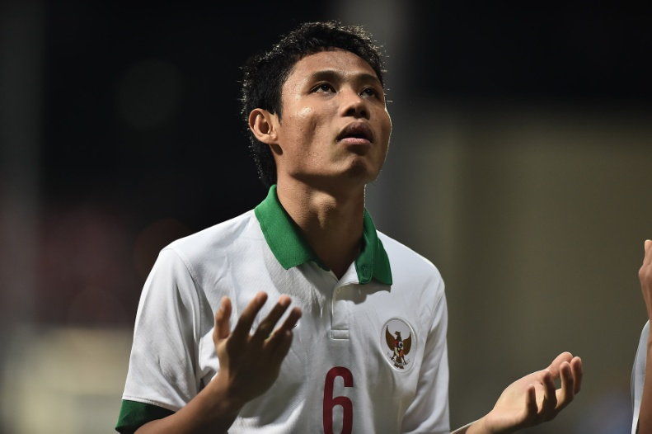
Read aloud.
I think Evan Dimas is one of the best young footballers in Indonesia. He is skilful and diligent. He usually plays as an attacking midfielder. He is tall and thin with short dark hair. He has a lot of fans. He is my idol.

Slide 11
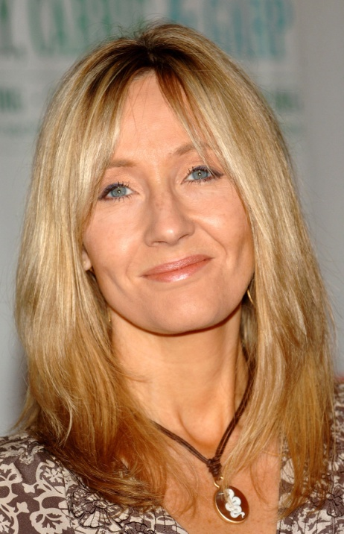
Read aloud.
My favorite author is J. K. Rowling. She is a very productive novel writer. She has written more than 10 books. She is medium height and has straight blonde hair. She is beautiful. She enjoys working on her laptop, writing books.

Slide 12
Think about it.
I think Evan Dimas is one of the best young footballers in Indonesia. He is skilful and diligent.
He usually plays as an attacking midfielder. He is tall and thin with short dark hair. He has a lot of fans. He is my idol.
topic
detailed
information

Slide 13
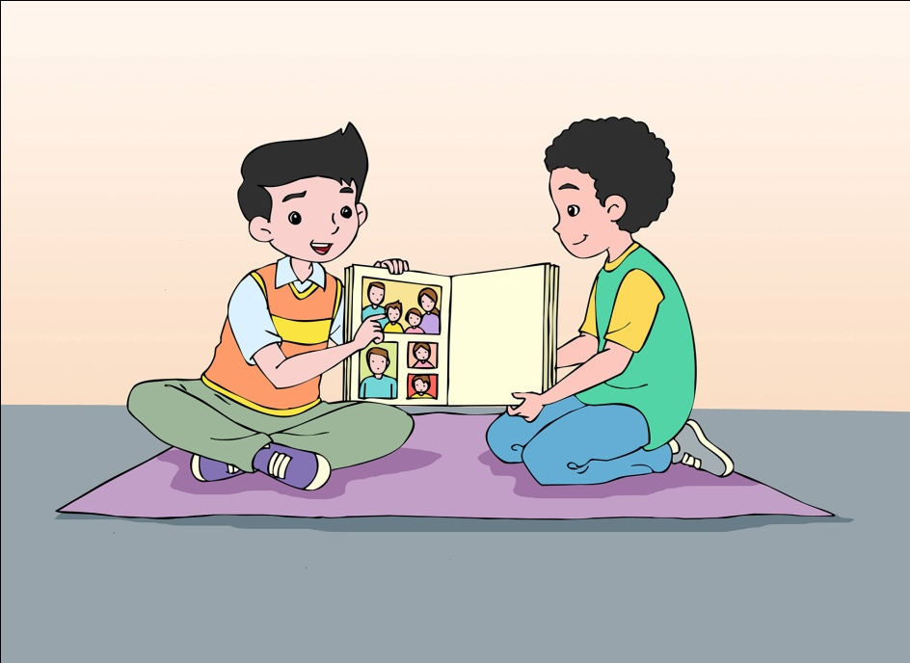
Make it real.
Find information about and a picture of your idol. Tell your friend about her/him.
`

Slide 14
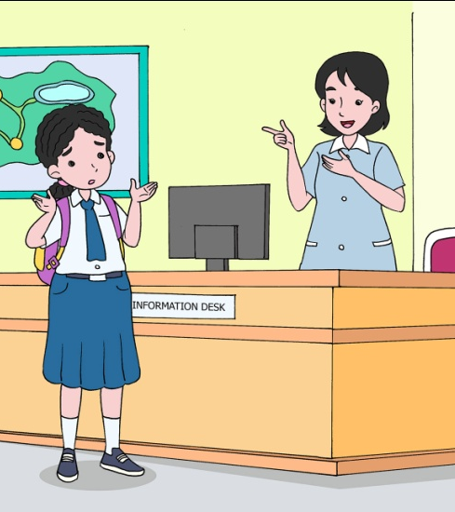
3. It’s red with white zippers.
Practice the dialog.
Thinneke and her classmates are visiting the science museum. She lost her backpack and she is not at the information desk.
Receptionist : Can I help you?
Thinneke : I have lost my backpack.
Receptionist : Your backpack? What is it like?

Slide 15

cont.
Thinneke : Well, it is red with white zippers and brown straps. It has one pocket at the front.
Receptionist : Alright. I’ll announce it. Hopefully you will get it back.
Thinneke : Thank you.

Slide 16

Act it out.
Work with a partner. Pretend you are at the information desk. You lost your backpack and now you are at the information desk to report it to the officer.
See
page 169.

Slide 17
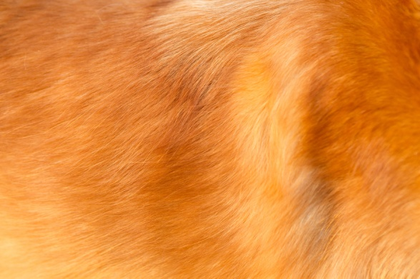

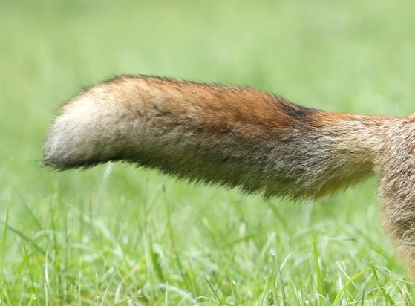
4. Blink-blink has a long golden tail.
Say them.
golden soft fur
long blue feather
long bushy tail

Slide 18
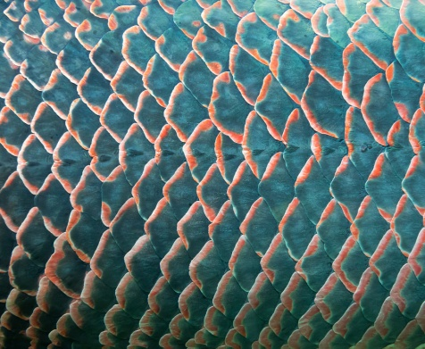
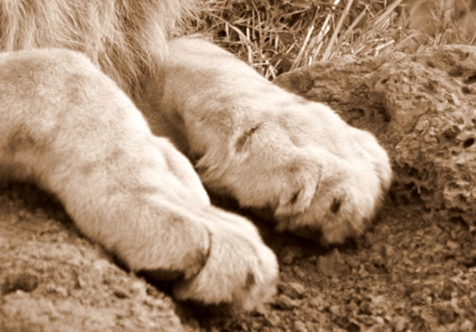
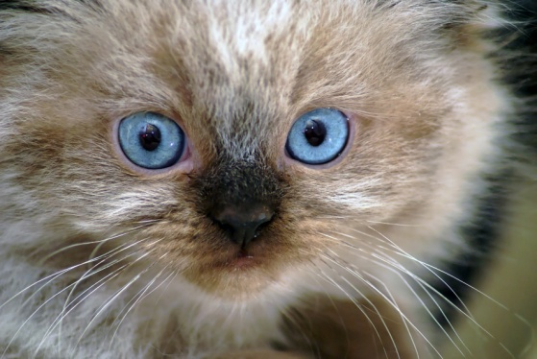
Say them.
shiny green scales
strong brown paws
blue round eye

Slide 19
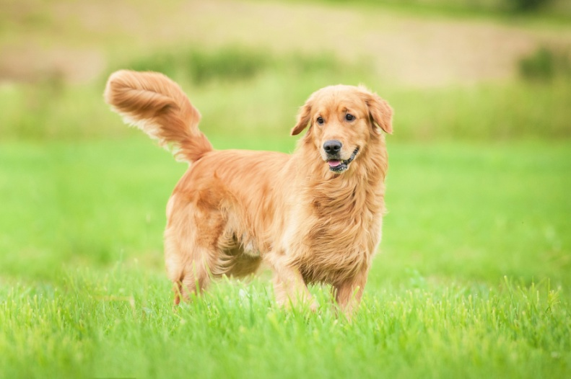
Read aloud.
Blink-blink My Golden Retriever
This is Blink-blink, my golden retriever. He is two years old. He has long golden tail. All parts of his body are golden, except his eyes, nose, and mouth. Blink-blink is an active and naughty dog. He loves to chew our shoes and sandals.

Slide 20
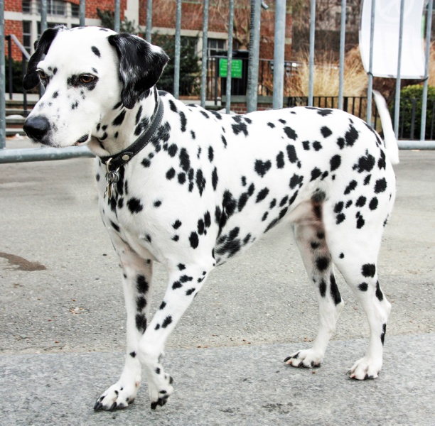
Read aloud.
Blontang, My Dalmatian
This is Blontang, my Dalmatian. She is one year old. She has round blue eyes and a short tail. She has short white fur with black spots. Blontang is a nice and funny dog. She loves to watch TV and roll on the floor.

Slide 21
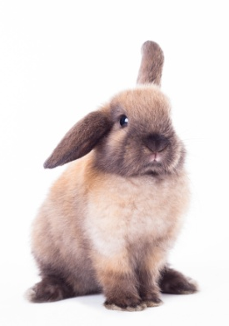
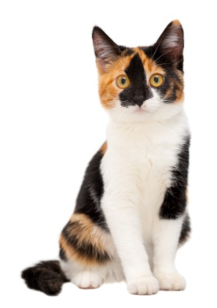
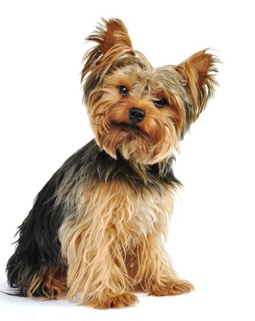
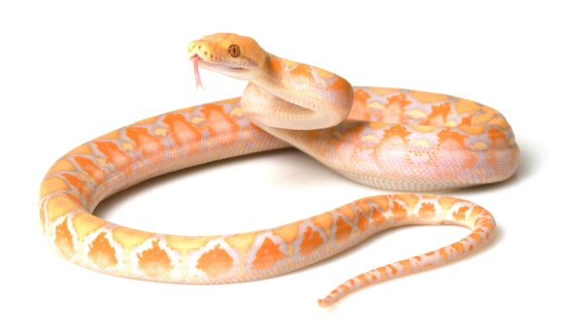
On your own
Write about a pet. Describe its age, physical appearance, and behaviors. You may state your good or bad things about the pet.

Slide 22
FYI
In western culture, people treat their pets as their family members.
The pronouns for a pet can be he or she.

Slide 23
Summary
A descriptive text consists of the topic and the detailed information.
Information to describe people: name, job, age, personality, physical appearance, behavior
Information to describe things: color, size, parts of things
Information to describe pets: name, kind of animal, body parts of animal, quality/character, behavior
We describe people, animals, or things to introduce, identify, or express good or bad things about them.

